Slide 1
SQL (Basic)
Vanessa Casillas
Graduate Fellow

Slide 2
Before we start
Download
DbeaverSqliteGUI environment
https://dbeaver.io/
Download and install Community version on local machine (installer available for Windows, Mac and Linux)
Survey
https://github.com/CMC-QCL/SQL

Slide 3
Agenda
SQL Overview
Relational Databases
Databases
Basics SQL Commands Hands-on
Resources
SQL Database Query Difference
Operation Order
Contact Info
Basic SQL Statements

Slide 4
If you want to…
See data
Relationship between data
Find any cell
Add data to cells
To add order to information

Slide 5
SQL Overview
Structured Query Language
Crud: create, read, update, delete
Create databases and tables
Look at specific data
Make changes to data and remove data
And more (level 2)

Slide 6
Relational Databases
A collection of tables
Set of columns in each table and rows with data
Each row is called a record
Data between tables can be related between each other
Collection of tables is called schema

Slide 7
Relational DBMS
Courses_Students
School_Courses
ID | ClassID | Semester
71225 | 1005 | Fall21
86634 | 1006 | Spr22
32238 | 1009 | Spr22
ClassID | Title | ClassNum
1005 | Intro to Art History | 500
1006 | Intro to SQL | 501
1009 | Intro to Datebases | 300
Students_Attendees
ID | Name | Grade | DOB
71225 | Lili | Freshman | 03/12/1995
32238 | Brenda | Senior | 05/28/1989
86634 | James | Freshman | 09/20/1999

Slide 8
The Relational Model
Primary Key
CustomerID | CustomerName | Status
1 | Instagram | Active
2 | Facebook | Active
3 | Myspace | Inactive
Row or Tuple
Rows are cardinality
Columns are degree
Table called a Relation
Column or Attribute

Slide 9
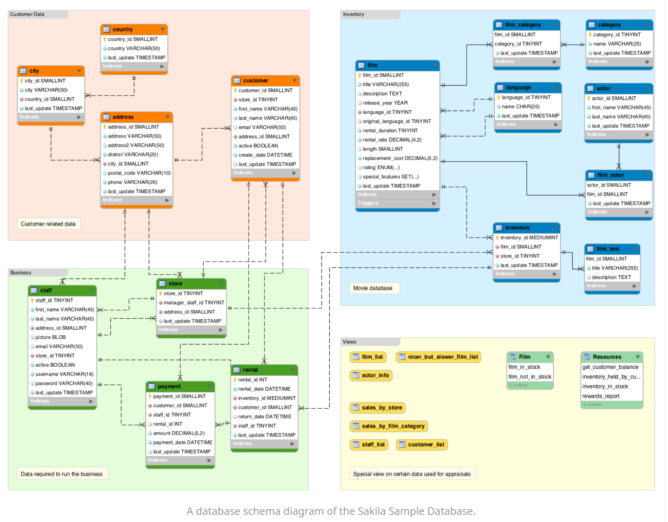
Schema Example
https://database.guide/what-is-a-database-schema/

Slide 10
Vocabulary
Data Definition Language (DDL):
CREATE, DROP, ALTER, TRUNCATE
Data Manipulation Language (DML):
INSERT, UPDATE, DELETE
Data Query Language (DQL):
SELECT, JOIN
Data Control Language (DCL):
GRANT, REVOKE

Slide 11
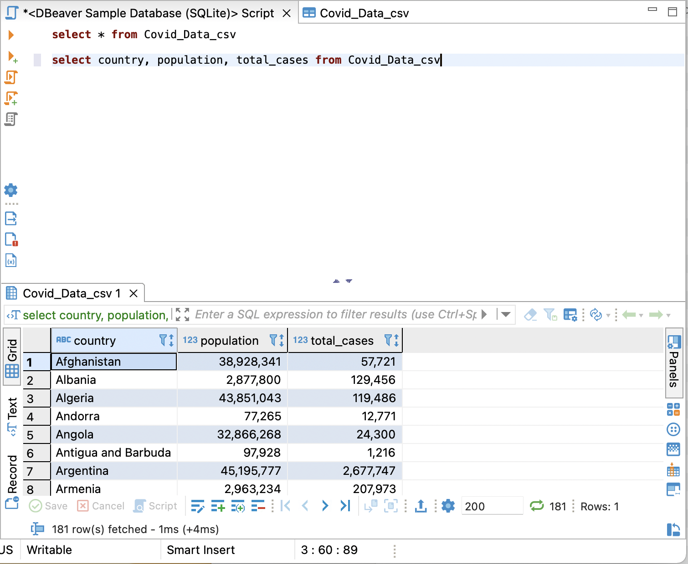
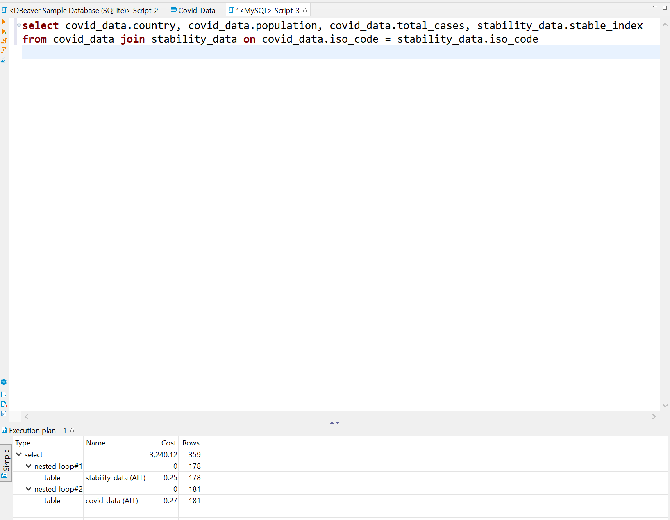
Basic SQL Statements
VIEW: virtual table
INDEX: users cannot see the index; it is used to retrieve data from the database more quickly

Slide 12
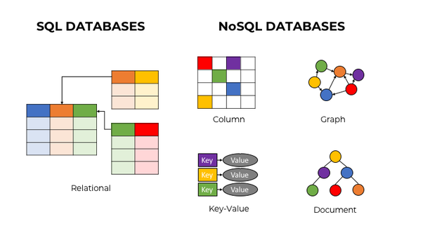
Relational Database management
system
Distributed Database
Management system
ACID compliant: (Atomicity, Consistency, Isolation, and Durability
CAP Theorem:
Consistency,
Availability,
Partitioning
Vertically Scalable
Fixed or predefined Schema
Dynamic Scalable
Dynamic Schema
Used for complex queries
Not good for complex queries

Slide 13
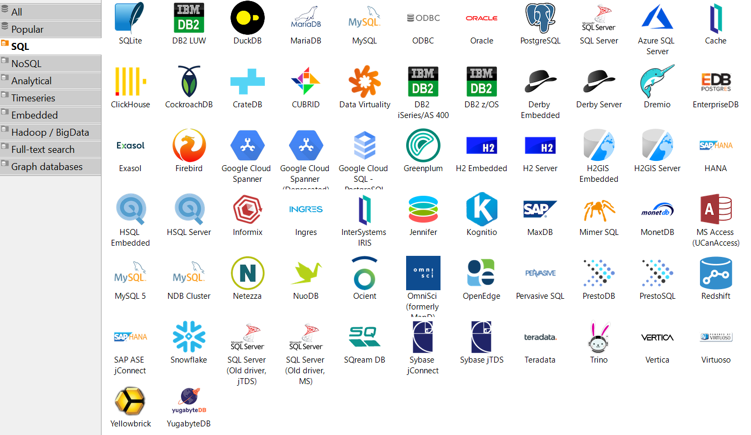
Relational SQL Databases

Slide 14
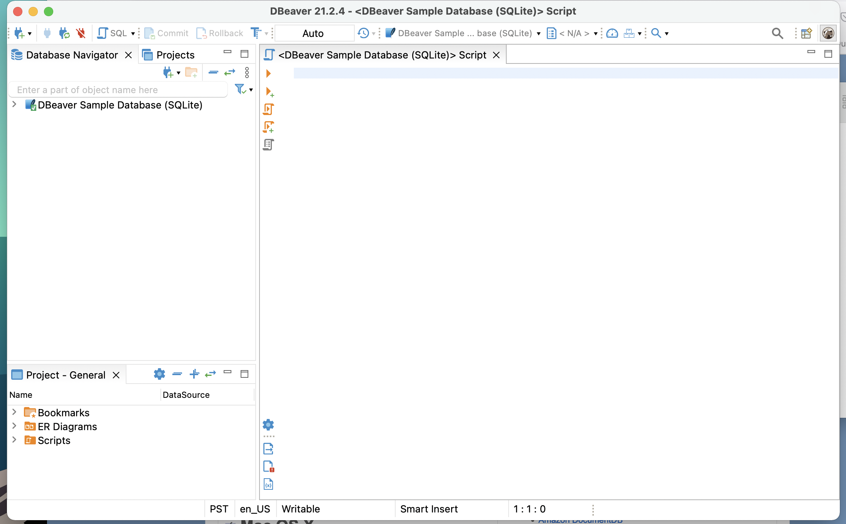
Interface
Choose your data base
Start a new script
Text Editor
Where you will write Queries
Connect Database
controls
Databases and Tables
View, Results, Execution
Project information

Slide 15


Today’s Goals
Whole - Big Picture
Parts – Small angles
Be able to take any data set and import into your database
Be able to sort and look through your data set
Be able to create your own data set and input data
Be able to join data sets together
Use basic SQL commands
Understand the process of writing a query
Understand how data can be joined
Understand the behind the scenes of how the query is operating

Slide 16

Today’s Data
Modified datasets for workshop (4 files total)
State Crime CSV File
state_crime.csv
information on the crime rates and totals for states across the United States for a wide range of years
reports go from 1960 to 2019 (only used 2010, 2014 and 2019)
https://corgis-edu.github.io/corgis/csv/state_crime/
State Demographics CSV and SQL Files
state_computer_data.sql, state_workforce.csv, state_people.sql
summarized information obtained about states in the United States from 2015 through 2019 through the United States Census Bureau
just the summarized data as of 2019
https://corgis-edu.github.io/corgis/csv/state_demographics/
https://corgis-edu.github.io/corgis/

Slide 17

Basic SQL Commands Hands-on

Slide 18
Hands-on Agenda
Import a data table called state_crime
Query using the SELECT statement with *
Filter a query using the WHERE clause and ORDER BY
Create data table called state_computer_data
Insert state_computer_data from sql file
Relate the two tables using the JOIN connector make Alias
Use Group by to look sort the data set
Throughout the workshop: Activities involving files named state_workforce and state_people

Slide 19
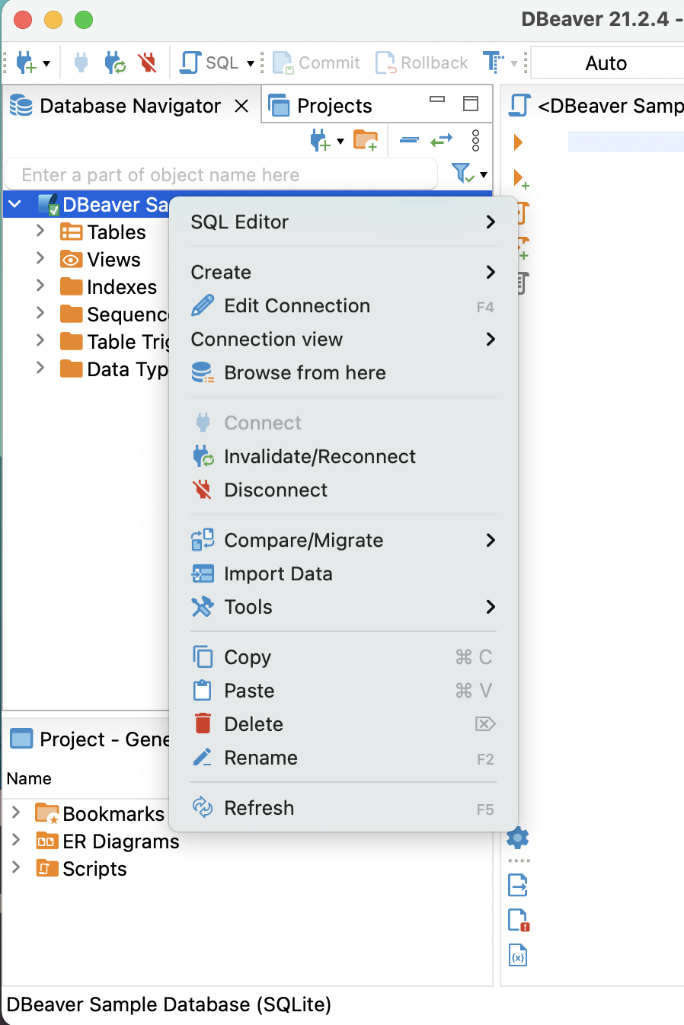
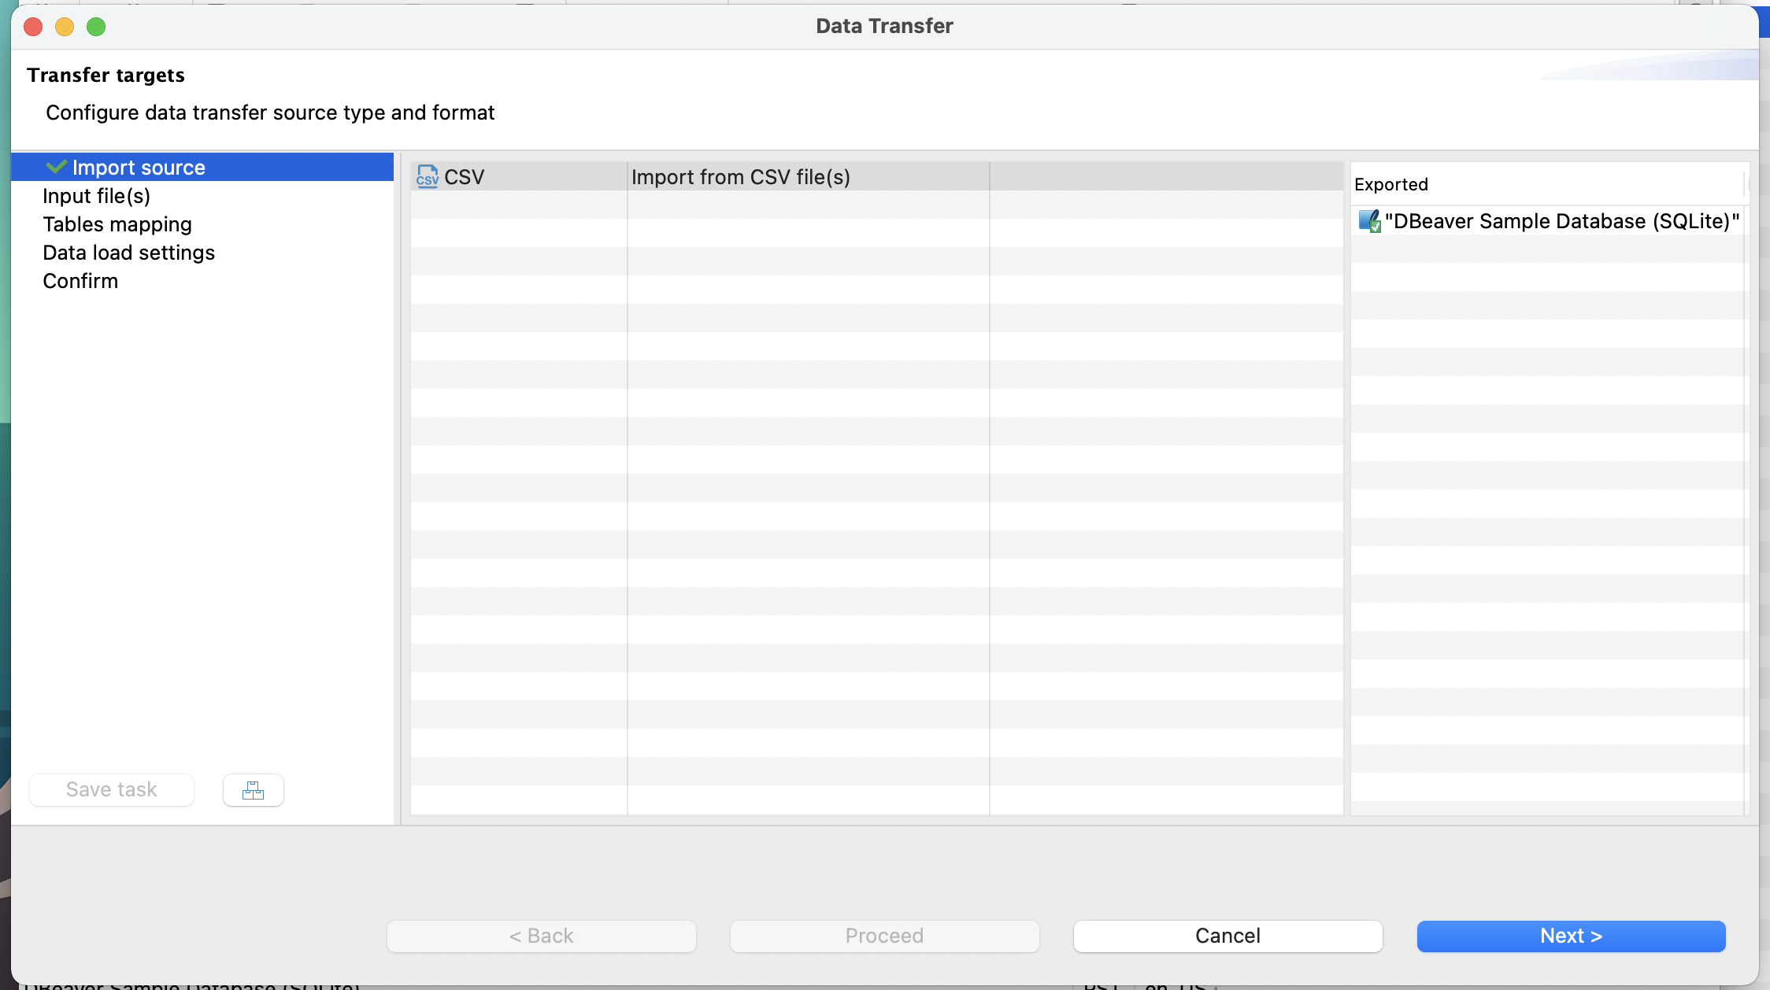
Import CSV

Slide 20
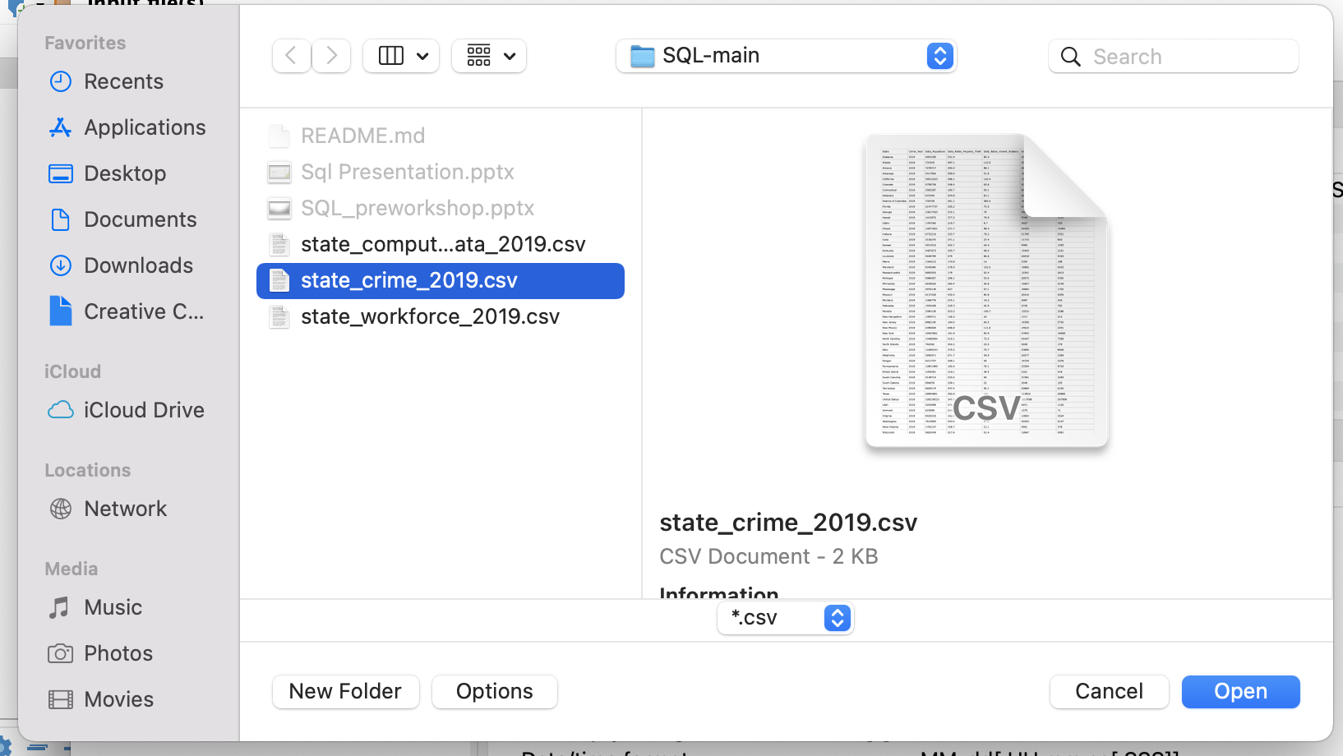
Import CSV (cont.)

Slide 21
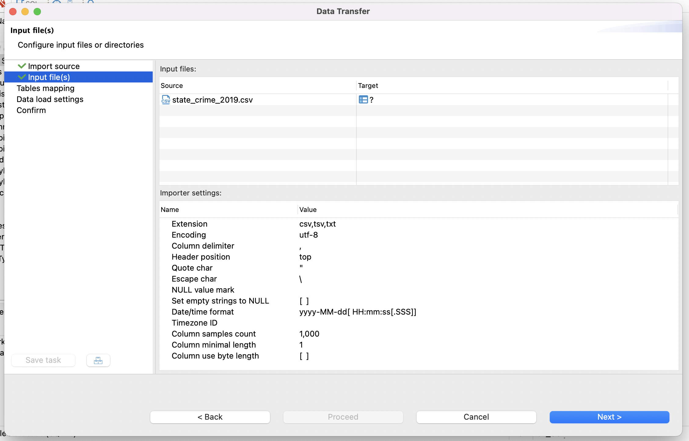
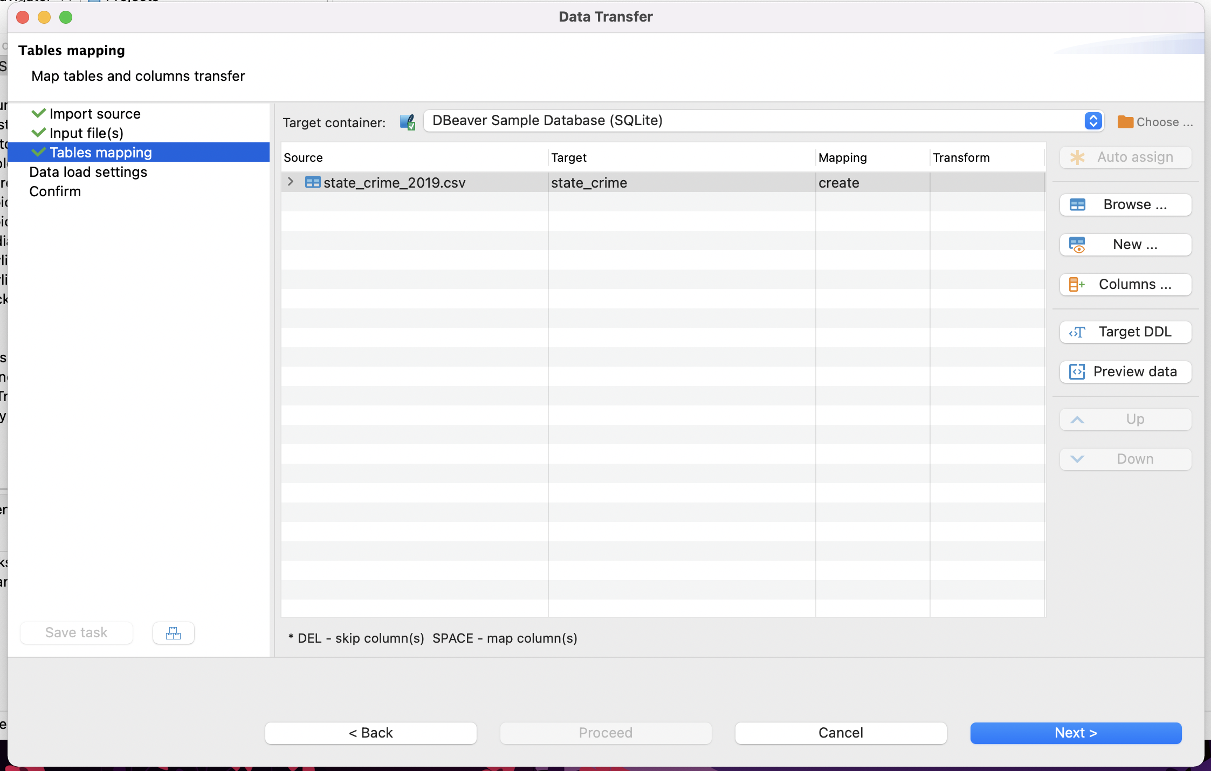
Import CSV (cont.)
Old versions of DBeaver will not see this

Slide 22
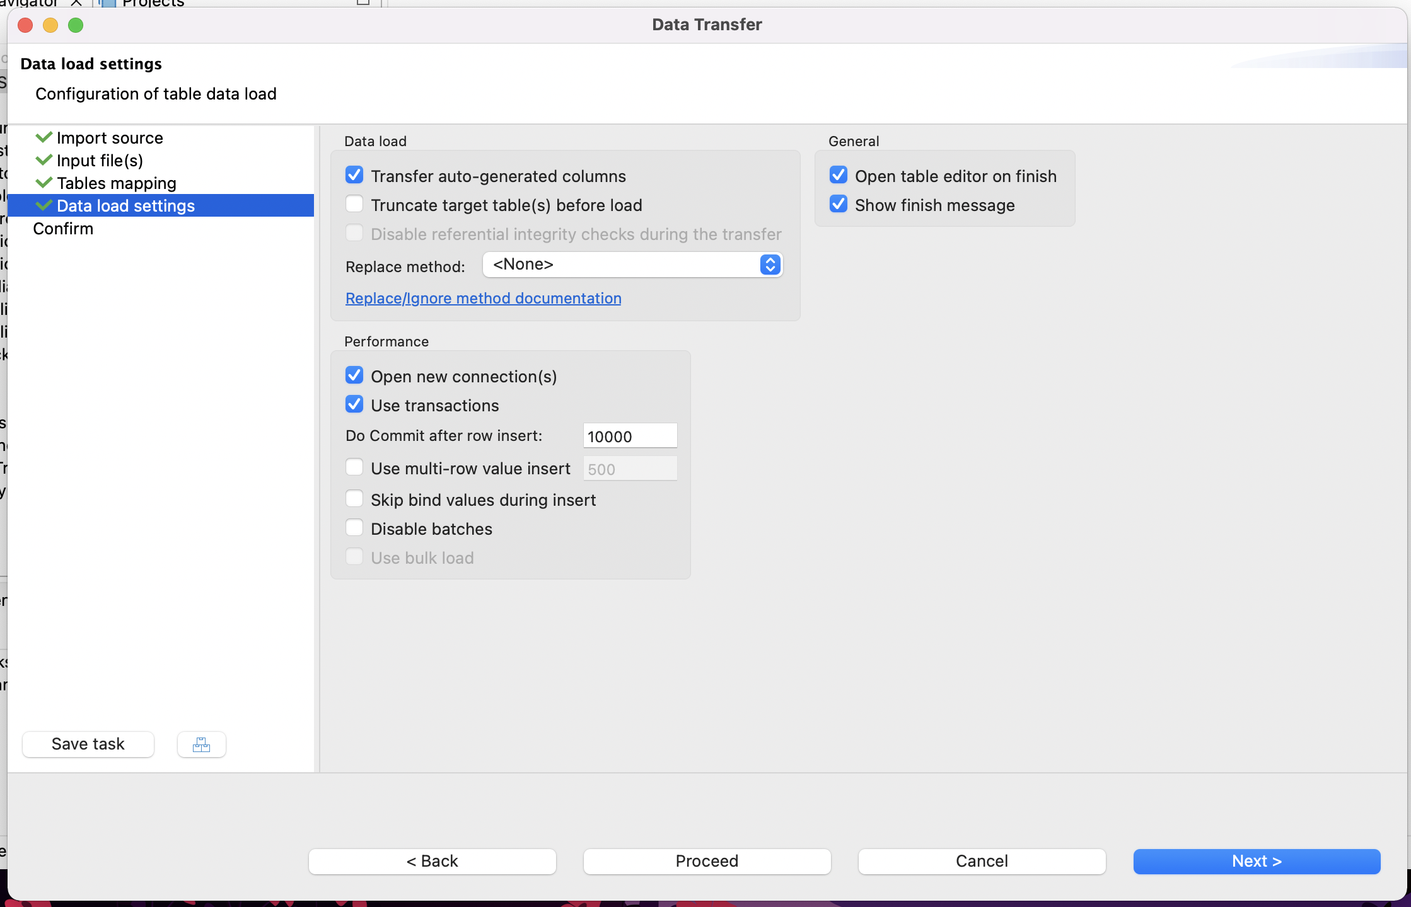
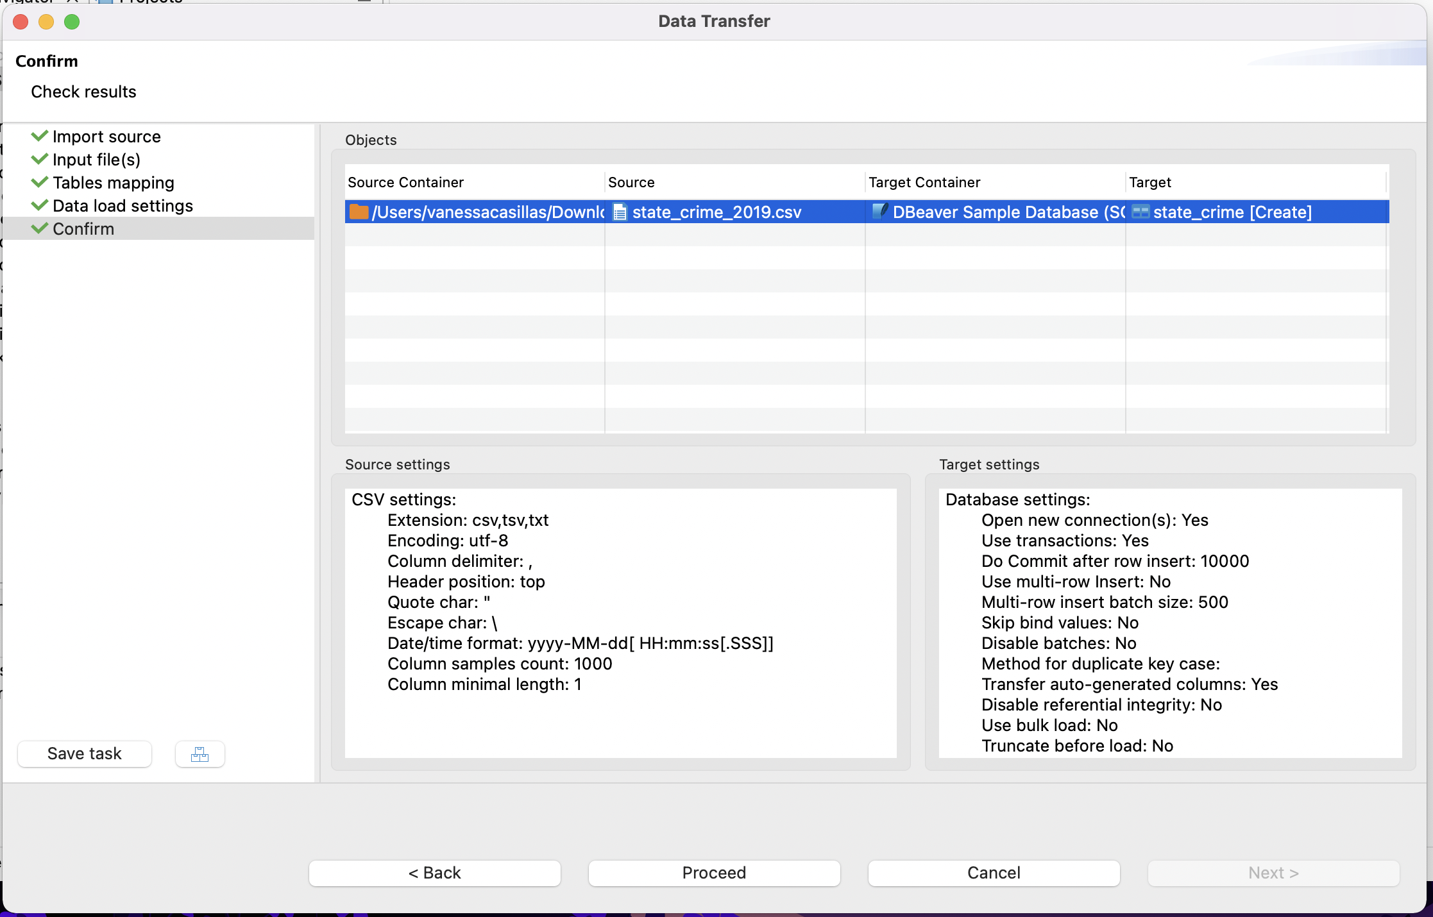
Import CSV (cont.)
Old versions of DBeaver will see start instead

Slide 23
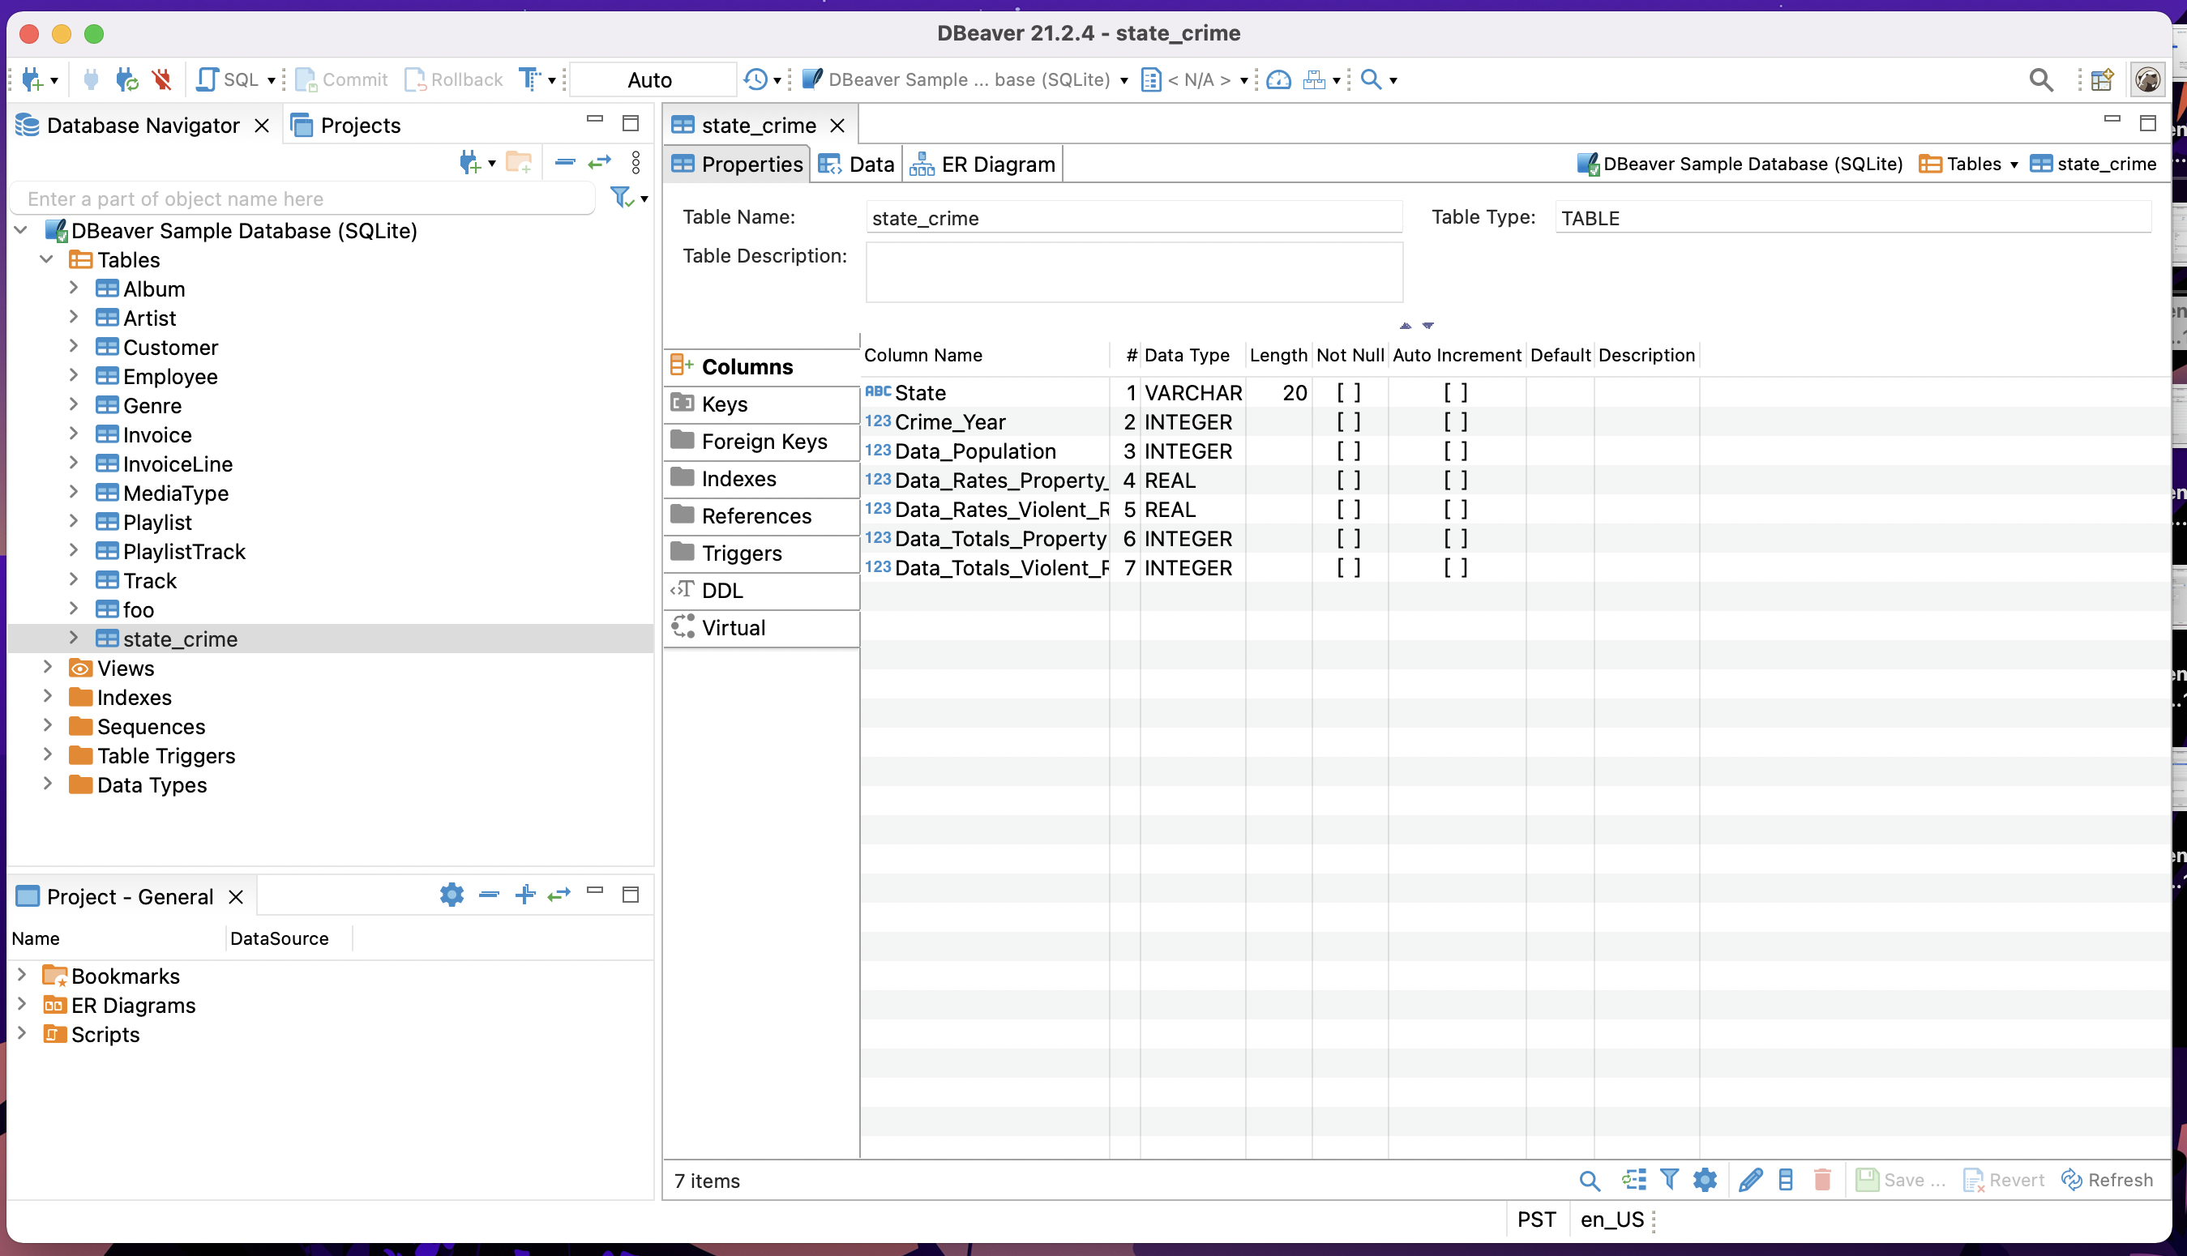
Successful Import of CSV

Slide 24
Writing Query
Select – Returns the data that was requested
From – choose a table to draw information from
Join – matches records from different tables
Where – filters data bases on request
Group By – aggregates the data
Having – filers aggregated data
Order by – sorts the data
Limit – limit the number of rows returned

Slide 25
Select
select * from state_crime;
Questions
Will show all the data within the table due to the wildcard
How many rows?
How many attributes?

Slide 26
Detailed view
SELECT column1, column2, ... FROM table_name;
*
:wildcard (select all)
select * from state_crime;
Table name
syntax
what table?
What do you want to see?

Slide 27
Select
select Data_Population, Data_Totals_Property_Theft, Data_Totals_Violent_Robbery from state_crime;
Will show the columns that we like to see only

Slide 28
Detailed view
SELECT column1, column2, ... FROM table_name;
select Data_Population, Data_Totals_Property_Theft,Data_Totals_Violent_Robbery from state_crime;
What do you want to see?
Column names
syntax
what table?
Table name

Slide 29
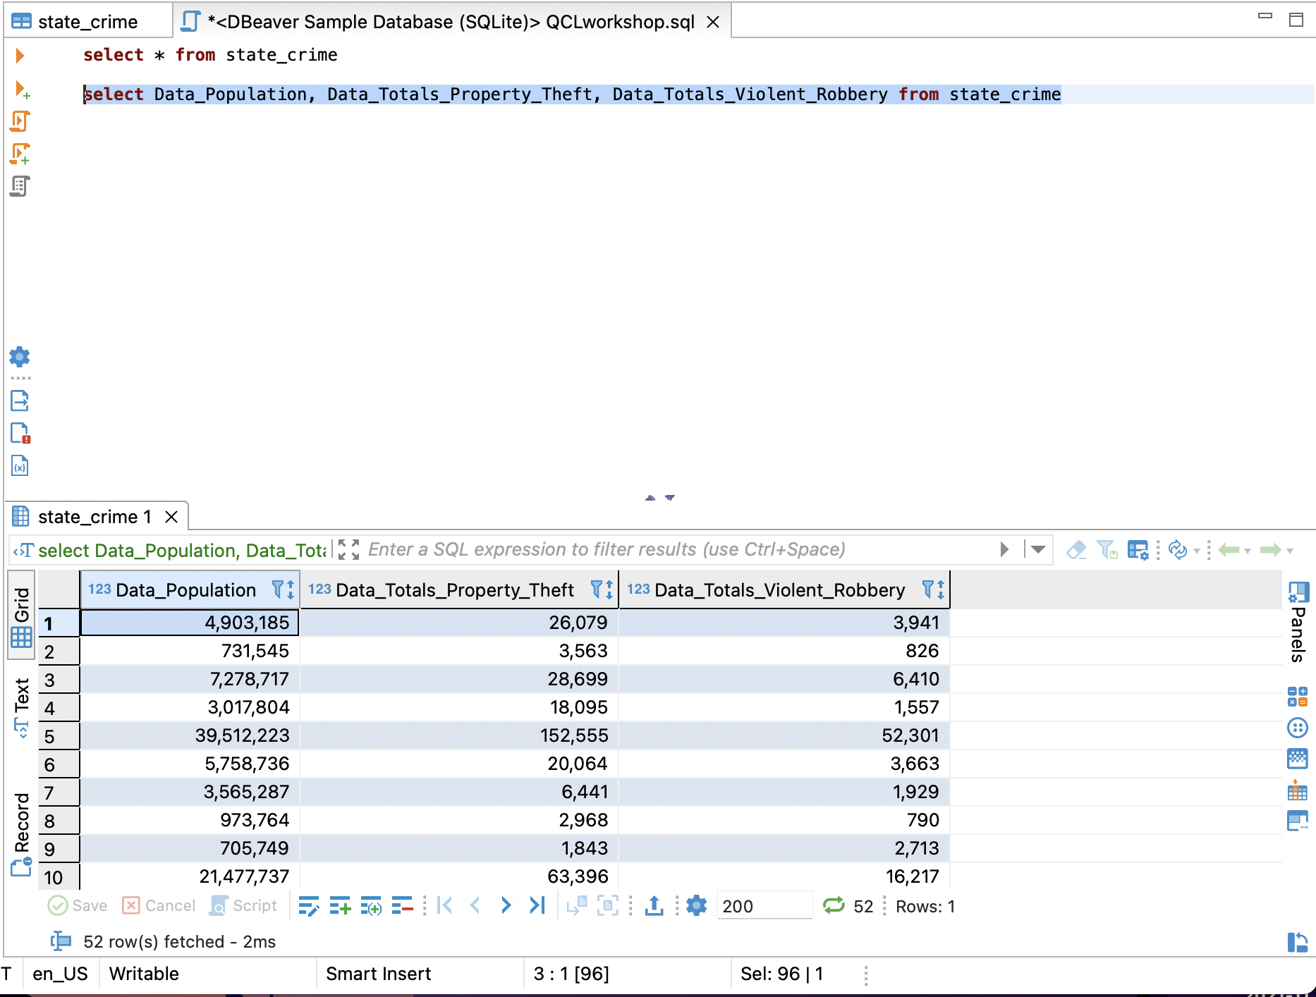

Slide 30

Activity #1 – Select
Import the file named state_workforce
How many rows and attributes does this table have?

Slide 31
Where Clause
select Data_Population, Data_Totals_Property_Theft, Data_Totals_Violent_Robbery from state_crime where Data_Totals_Violent_Robbery >=3000;

Slide 32
Detailed view
SELECT column1, column2, ... FROM table_name WHERE condition;
select Data_Population, Data_Totals_Property_Theft, Data_Totals_Violent_Robbery from state_crime where Data_Totals_Violent_Robbery >=3000;
What do you want to see?
Column names
what table?
Table name
syntax
Clause: to filter
Condition

Slide 33
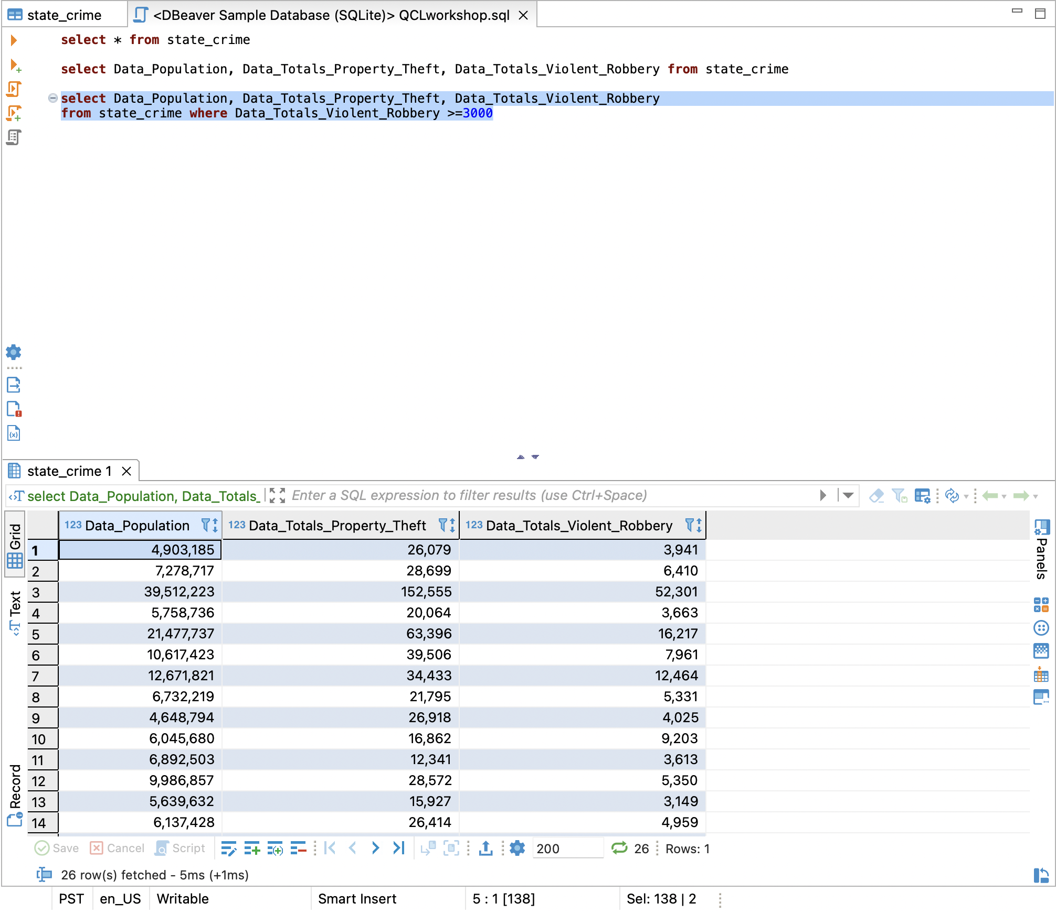

Slide 34
Order by
select State, Data_Population, Data_Totals_Property_Theft,Data_Totals_Violent_Robbery, Crime_Year from state_crime where Data_Totals_Violent_Robbery >=3000 order by Data_Population DESC;
Default is asc

Slide 35
Detailed view
SELECT column1, column2, ... FROM table_name WHERE condition;
ORDER BY column1, column2, ... ASC|DESC;
select State, Data_Population, Data_Totals_Property_Theft, Data_Totals_Violent_Robbery, Crime_Year from state_crime where Data_Totals_Violent_Robbery >=3000 order by Data_Population DESC ;
What do you want to see?
Column names
what table?
Table name
Column and Condition
syntax
Column to sort by
Clause: to filter
Sort results in ascending or descending order

Slide 36
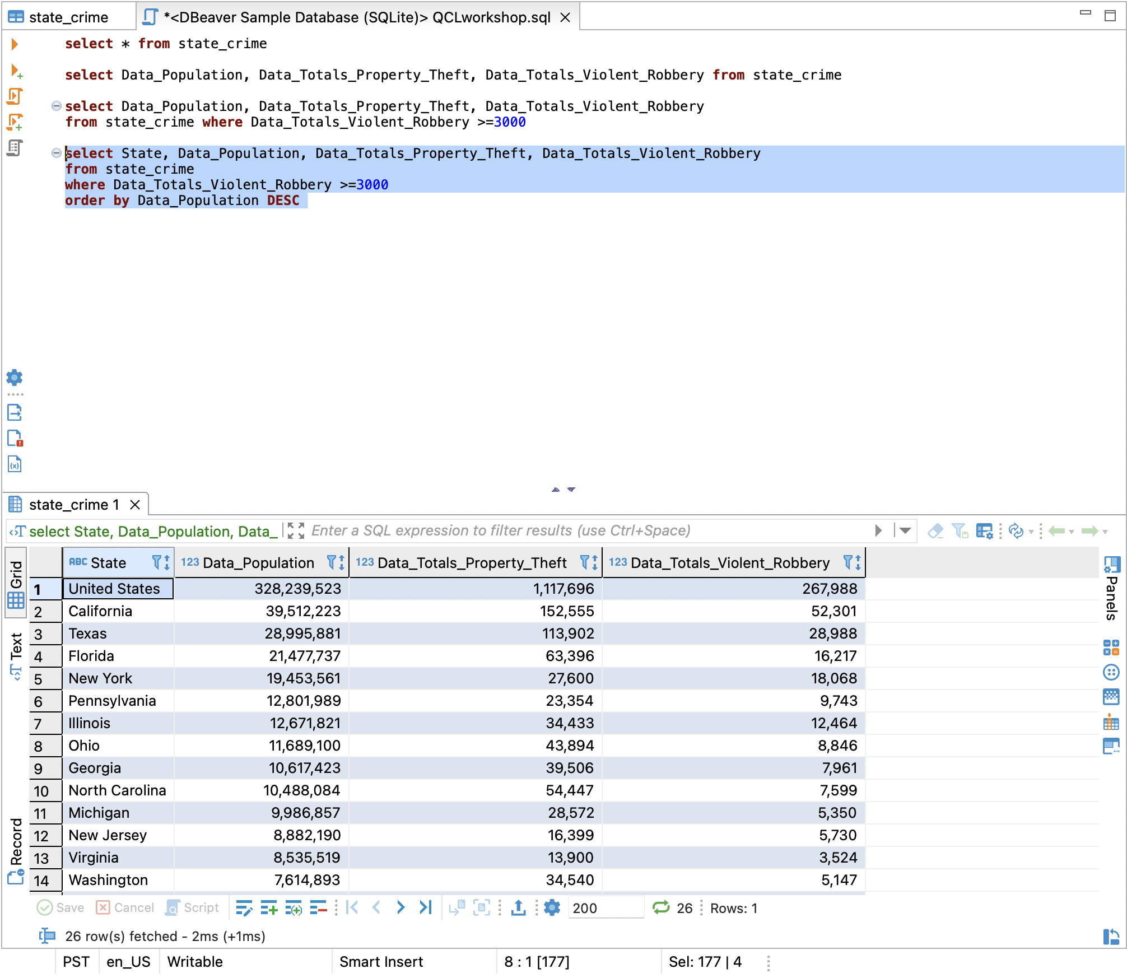

Slide 37
Activity #2 – Where Clause and Order by
Use where clause to find out how many people on average take longer than 20 mins to get to work?
Use Order by to find out what state has the longest on average time it takes to get to work?

Slide 38
Group By
select State, Data_Rates_Property_Theft, Data_Totals_Violent_Robbery, Data_Population from state_crime_csv where Data_Totals_Violent_Robbery > 10000 group by State order by Data_Totals_Violent_Robbery DESC;

Slide 39
Detailed view
SELECT column_name(s) FROM table_name WHERE condition GROUP BY column_name(s) ORDER BY column_name(s);
What do you want to see?
Column names
select State, Data_Rates_Property_Theft, Data_Totals_Violent_Robbery, Data_Population from state_crime_csv where Data_Totals_Violent_Robbery>10000 group by State order by Data_Totals_Violent_Robbery DESC;
what table?
Table name
Column and Condition
syntax
Clause: to filter
Puts rows that are similar together
Column to sort by
Sort results in ascending or descending order

Slide 40
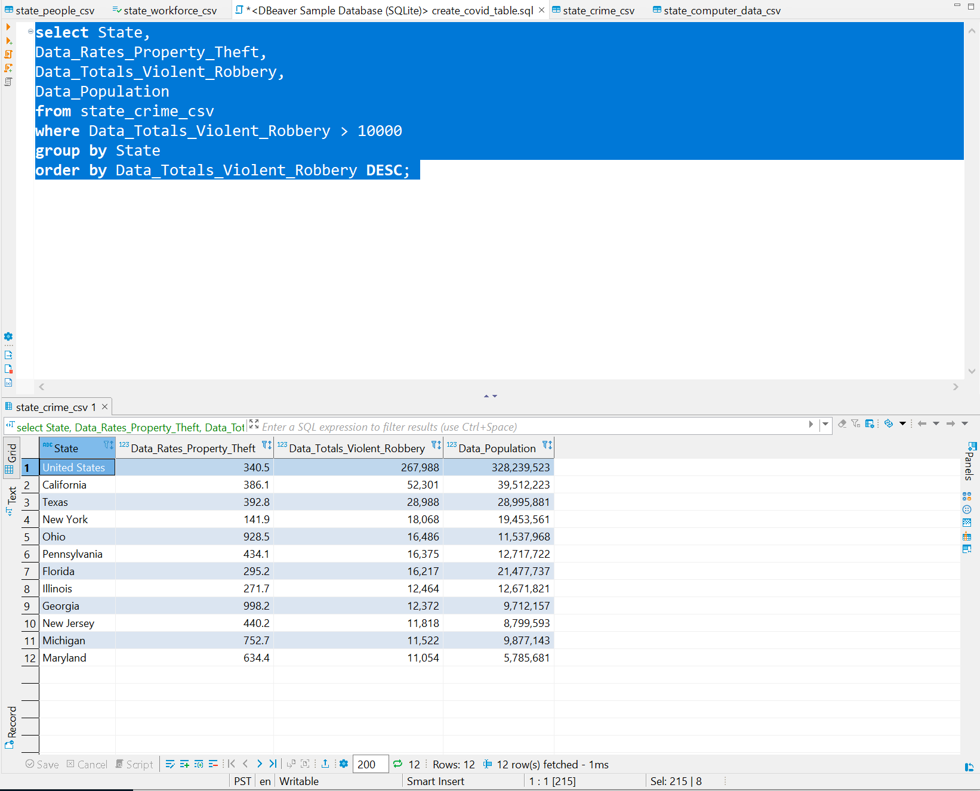

Slide 41
Create Table
create table state_computer_data_2019( State Varchar (20), Housing_Persons_per_Household Float, Housing_Households_with_a_computer Float, Housing_Households_with_a_Internet Float );

Slide 42
Detailed view
CREATE TABLE table_name ( column1 datatype, column2 datatype, column3 datatype, .... );
create table state_computer_data_2019 ( State varchar (20), Housing_Persons_per_Household float, Housing_Households_with_a_computer float, Housing_Households_with_a_Internet float );
create new table
Name to give table
Columns
Datatype
syntax

Slide 43
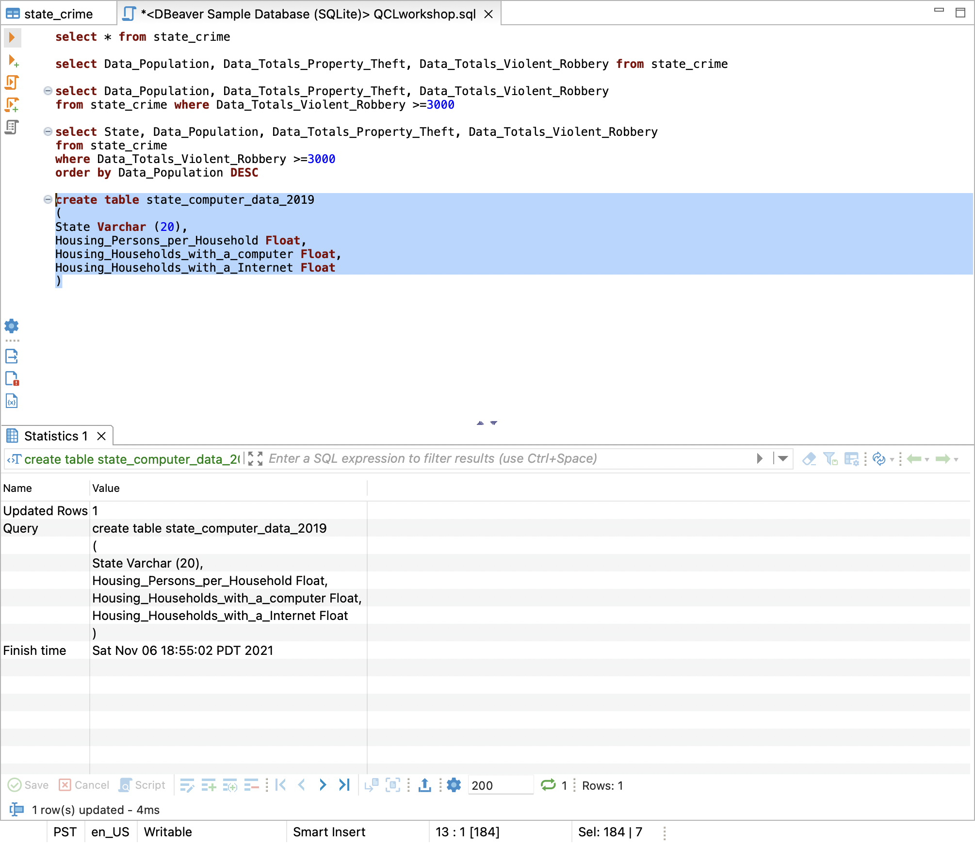

Slide 44
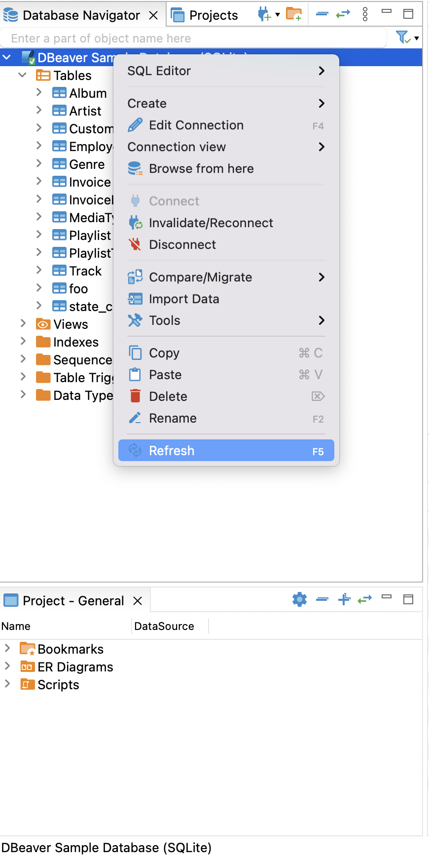
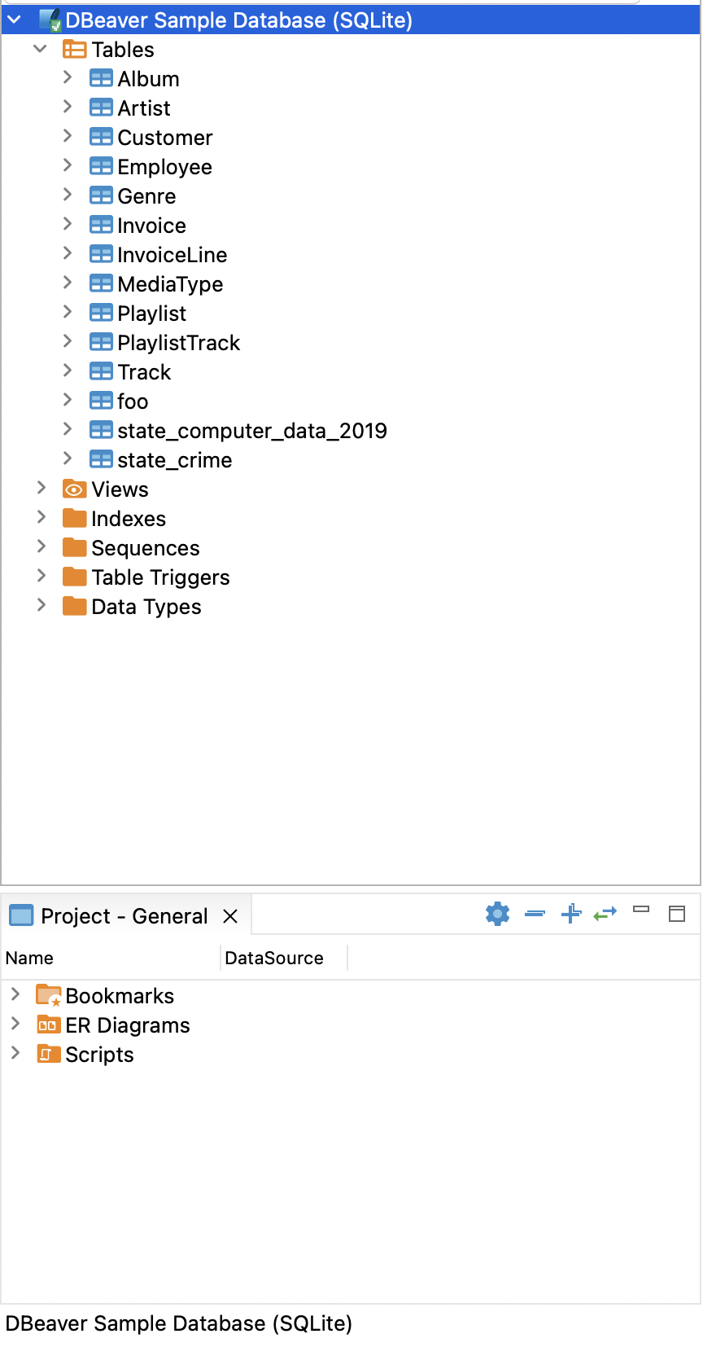
Refresh

Slide 45
Insert and Detail View
INSERT INTO table_name (column1, column2, column3, ...) VALUES (value1, value2, value3, ...);
insert into state_computer_data Values('Alabama', 2.55, 85.5, 76.4);
select * from state_computer_data;
(breakdown in section of select statement)
insert into state_computer_data values('Alabama', 2.55, 85.5, 76.4);
Put data into table
Table
syntax
Tell program to input this information
Data that you are inputting

Slide 46
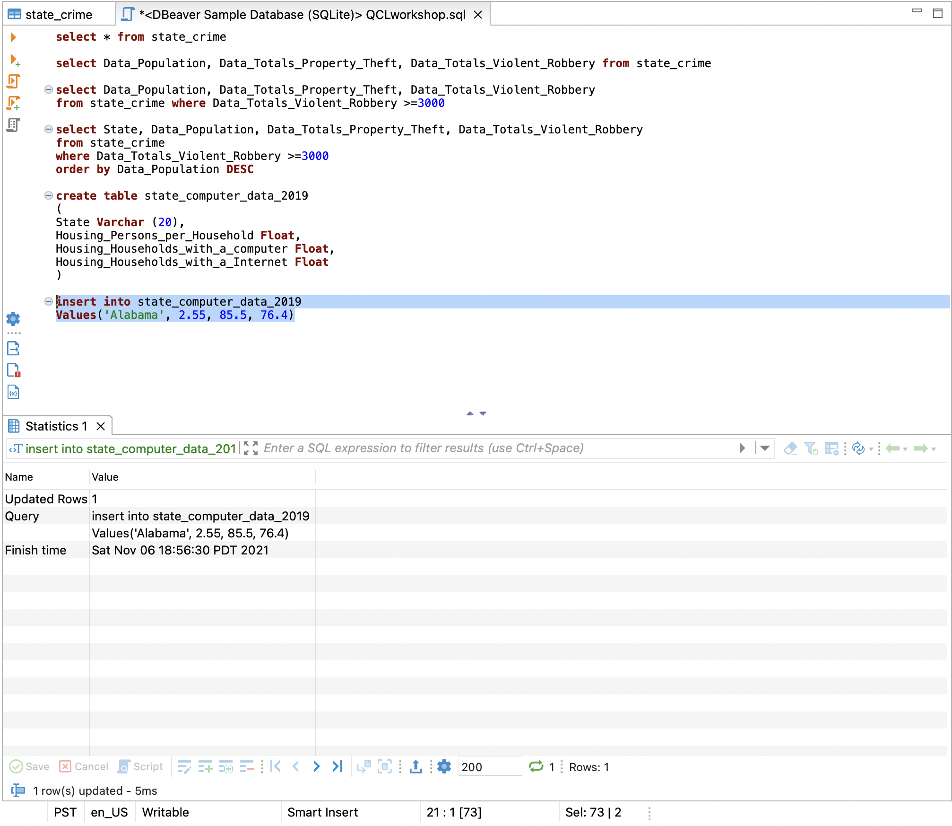
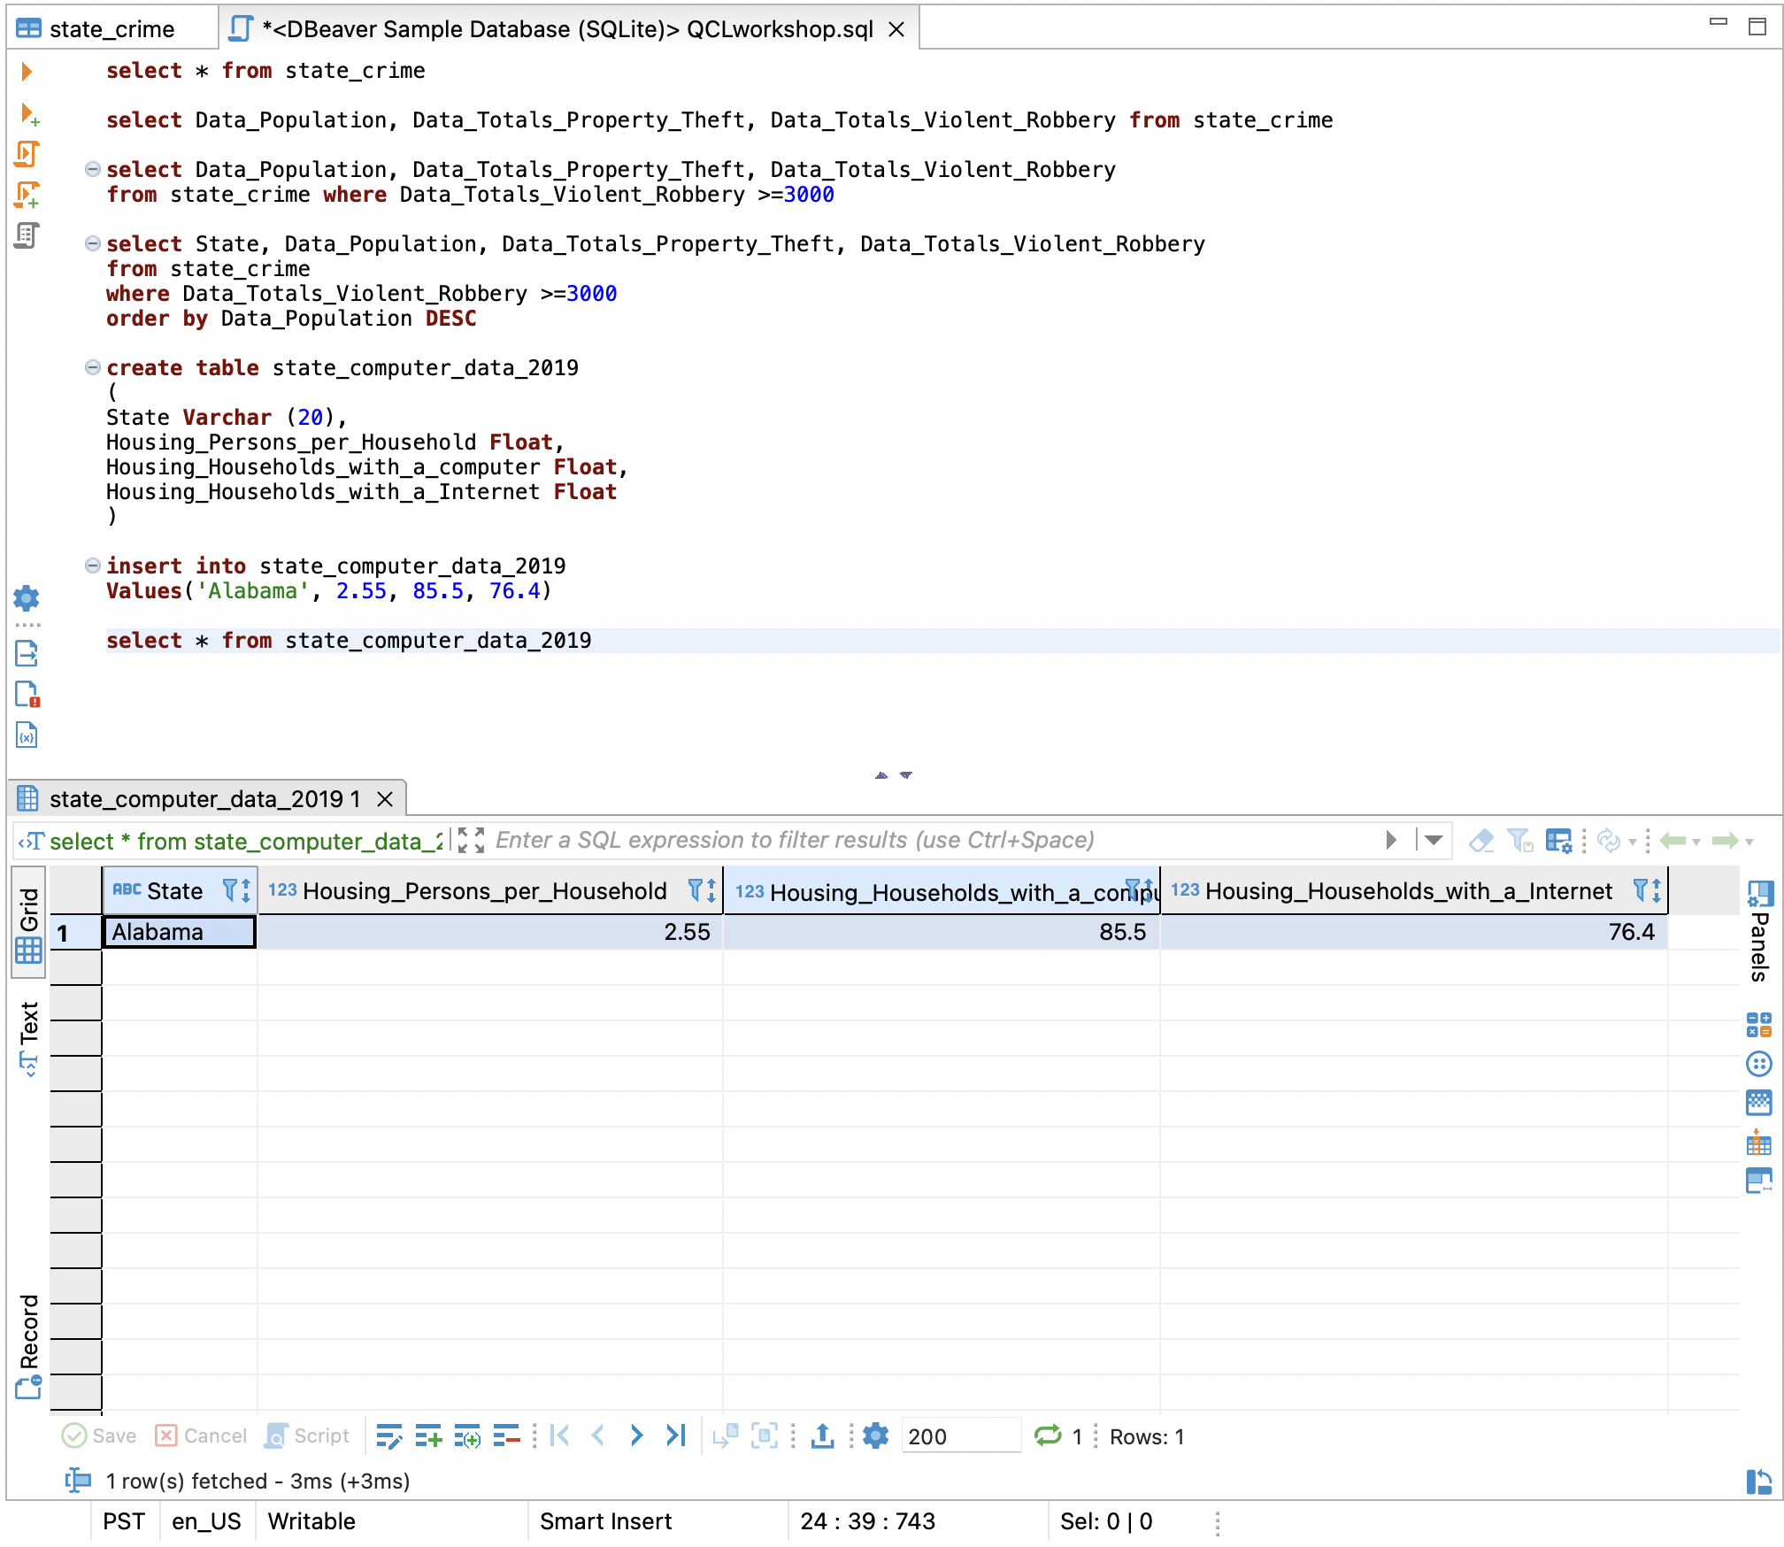

Slide 47
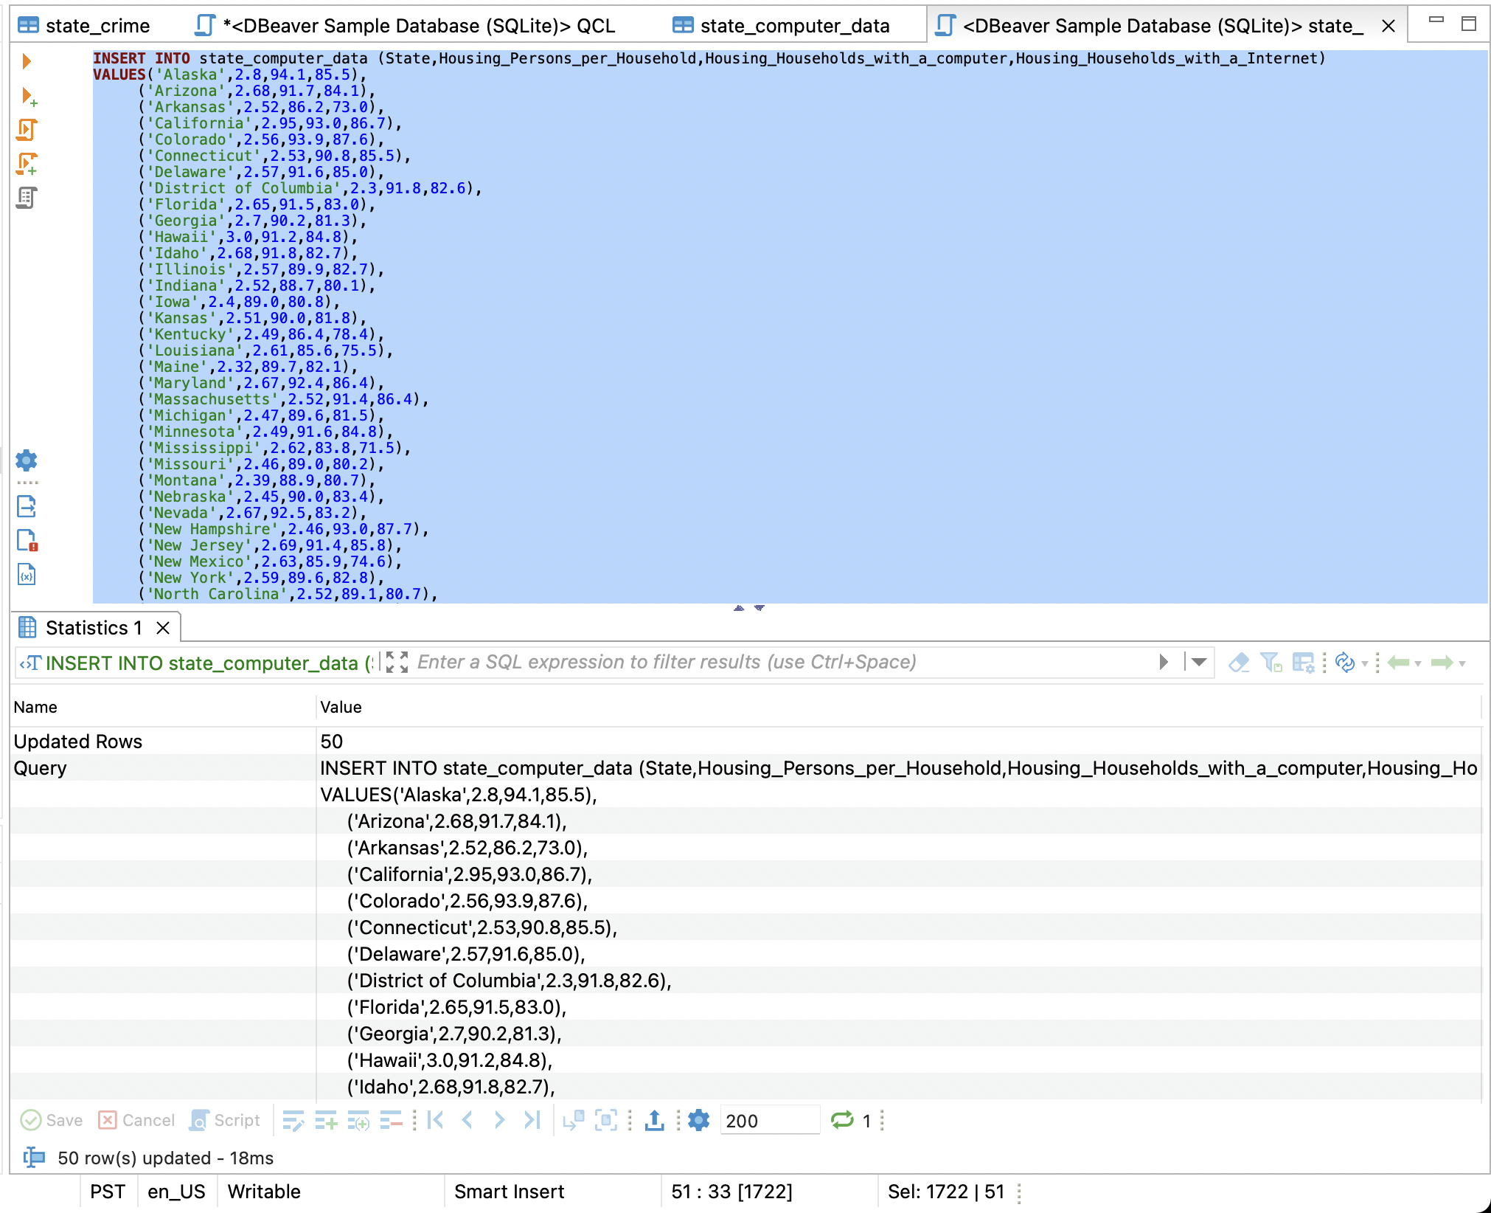
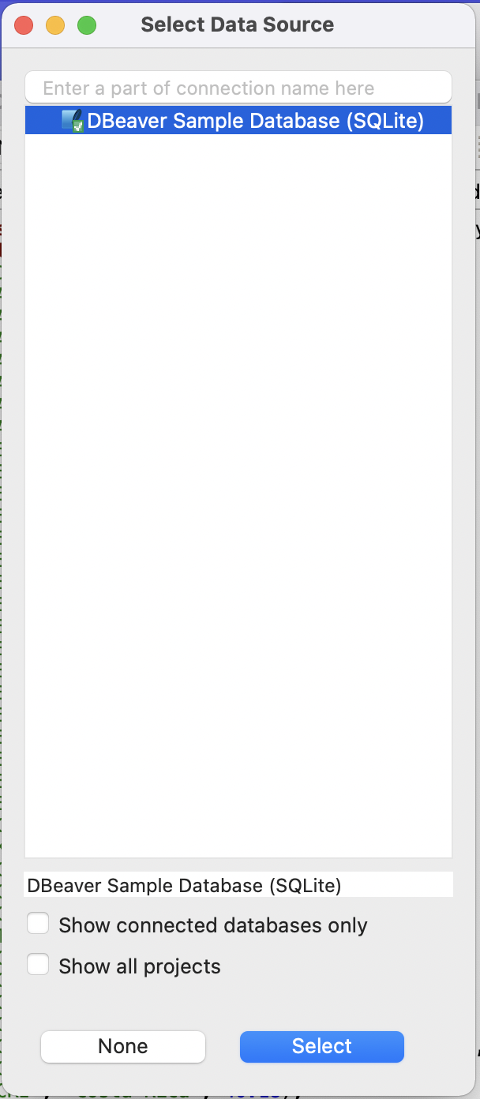
Insert data (alternative)
Load state_computer_data.sql
Click on data source
Click select

Slide 48
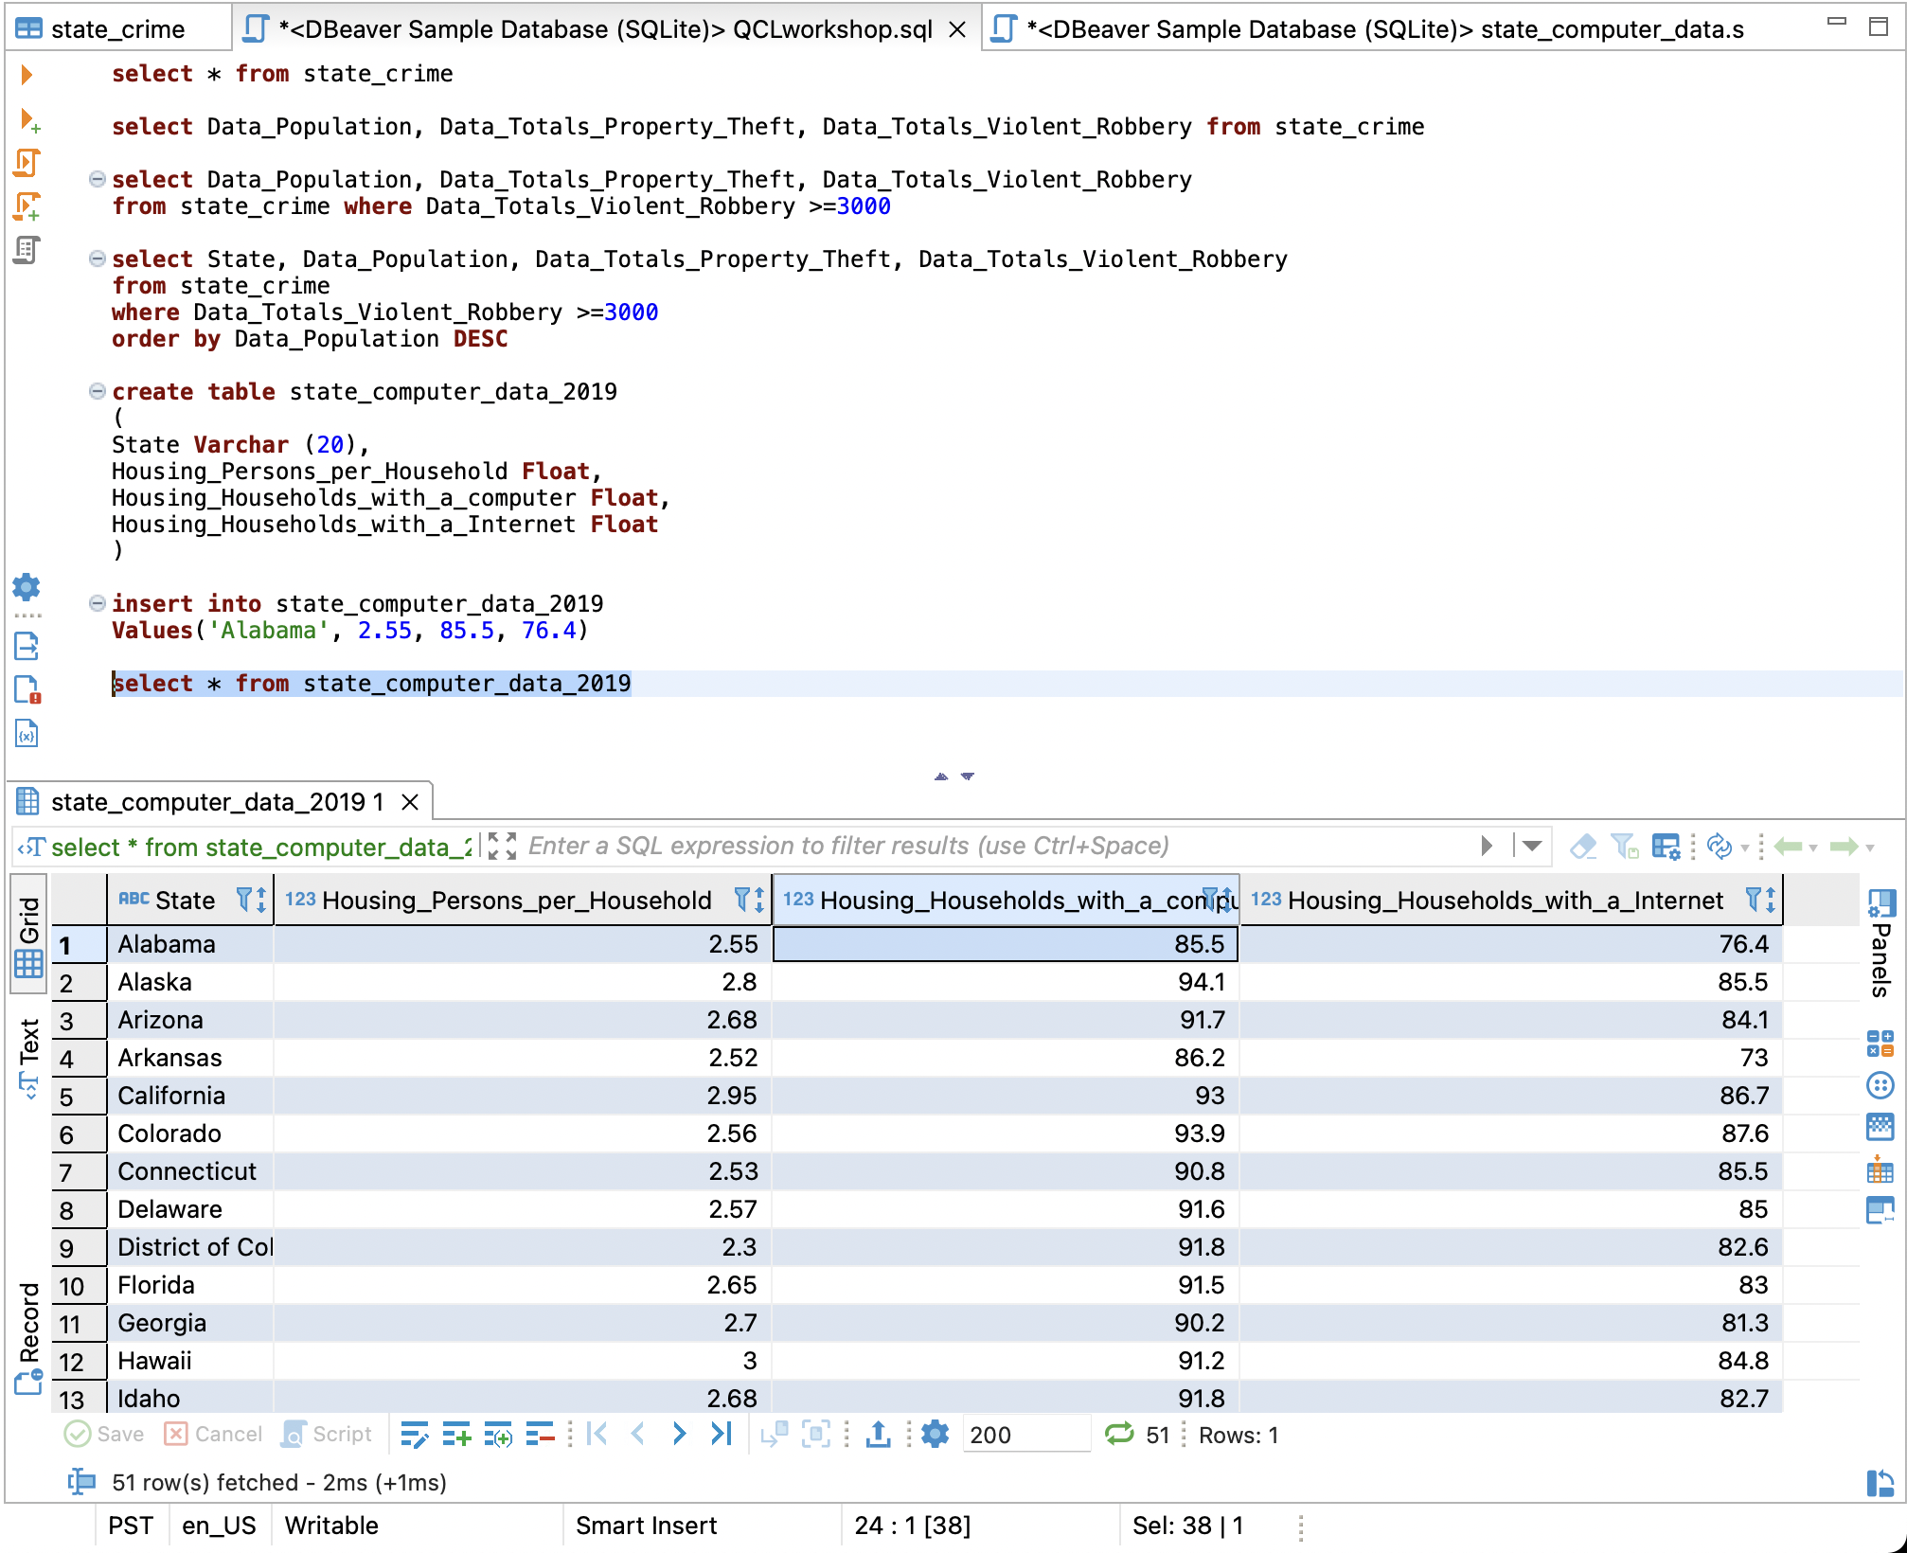
Insert data (cont.)
select * from state_computer_data;
(breakdown in section of select statement)
Look at table data
Which column looks like a column that has the same information for both tables?

Slide 49
Activity #3 – Create Table and Insert Data
Create a table named state_people and add the attributes: State as a varchar with 20 characters, Employment_Firms_Total as a integer, Employment_Firms_Men_Owned as a integer, Employment_Firms_Women_Owned as a integer, Age_Percent_Under_18_Years as a float, and Age_Percent_65_and_Older as a float.
Insert data into your new table called state_people using a sql file in the downloaded github folder

Slide 50
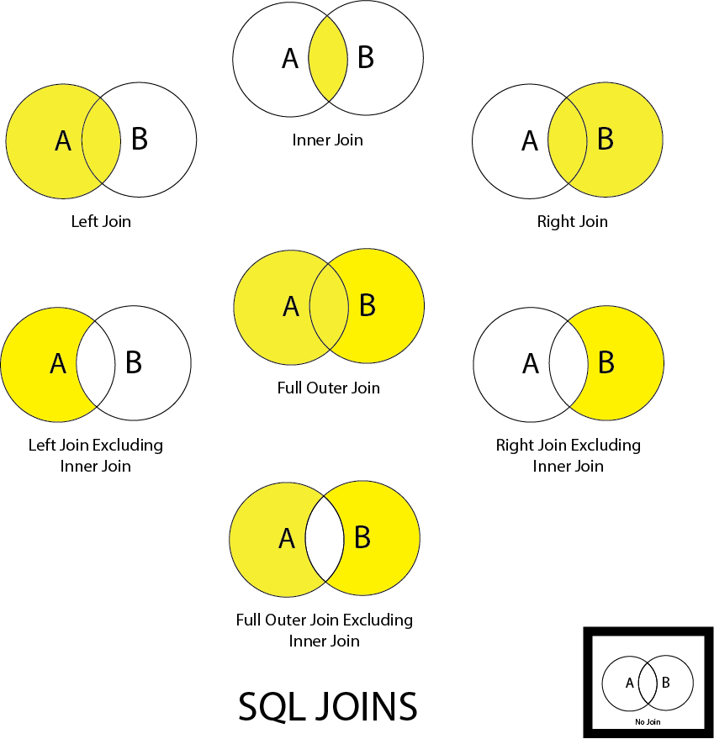
Made in Adobe Illustrator

Slide 51
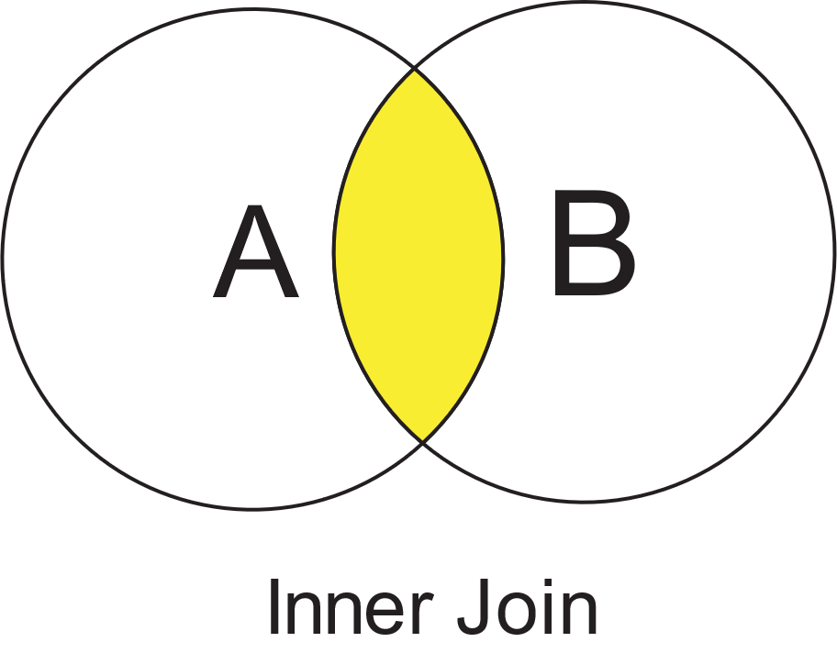
Inner Join
select state_computer_data.State, state_computer_data_2019.Housing_Households_with_a_computer, state_crime.Data_Totals_Property_Theft from state_computer_data join state_crime on state_computer_data.state = state_crime.State;

Slide 52
Detail View
SELECT column_name(s) FROM table1 INNER JOIN table2 ON table1.column_name = table2.column_name;
select state_computer_data.State, state_computer_data.Housing_Households_with_a_computer, state_crime.Data_Totals_Property_Theft from state_computer_data join state_crime on state_computer_data.state = state_crime.State;
What do you want to see?
Table name
Column names
what table?
syntax
What table are you joining and on what columns?
You can just join if you are making an inner join, yet if you are making any other join, you do have to specify

Slide 53
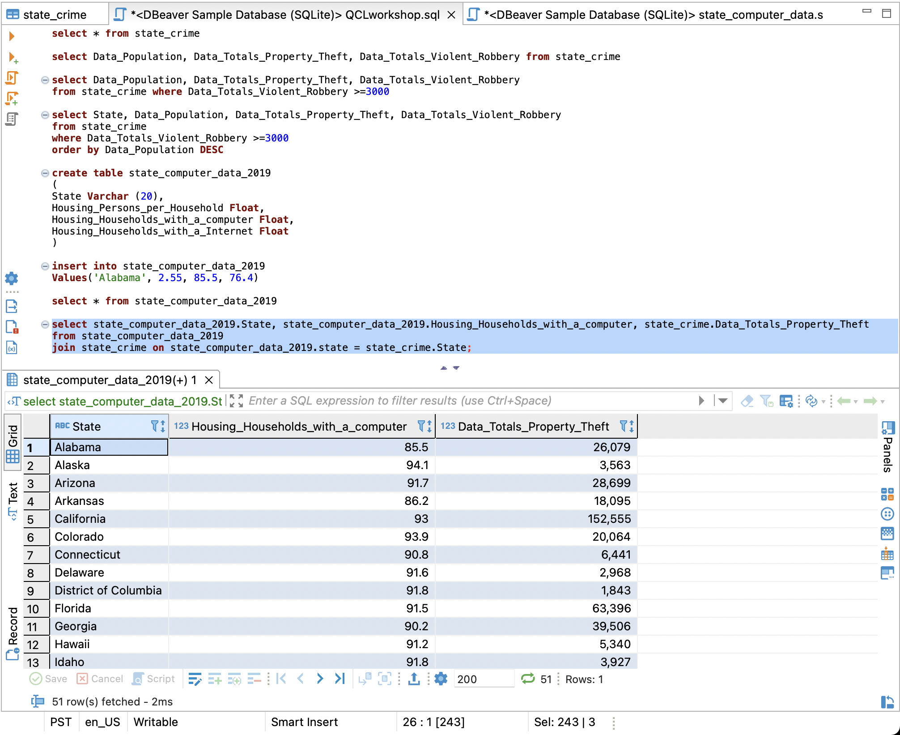

Slide 54
Alias
select a.State, a.Housing_Households_with_a_computer, b.Data_Totals_Property_Theft, b.Data_Totals_Violent_Robbery from state_computer_data_2019 as a join state_crime as b on a.state = b.State;

Slide 55
Detail View
SELECT column_name(s) FROM table_name AS alias_name;
What do you want to see?
select a.State, a.Housing_Households_with_a_computer, b.Data_Totals_Property_Theft, b.Data_Totals_Violent_Robbery from state_computer_data as a join state_crime as b on a.state = b.State;
Table name
Column names
Give the table an alias name must put “as” to assign it
what table?
syntax
What table are you joining and on what columns?
You can just join if you are making an inner join, yet if you are making any other join, you do have to specify

Slide 56
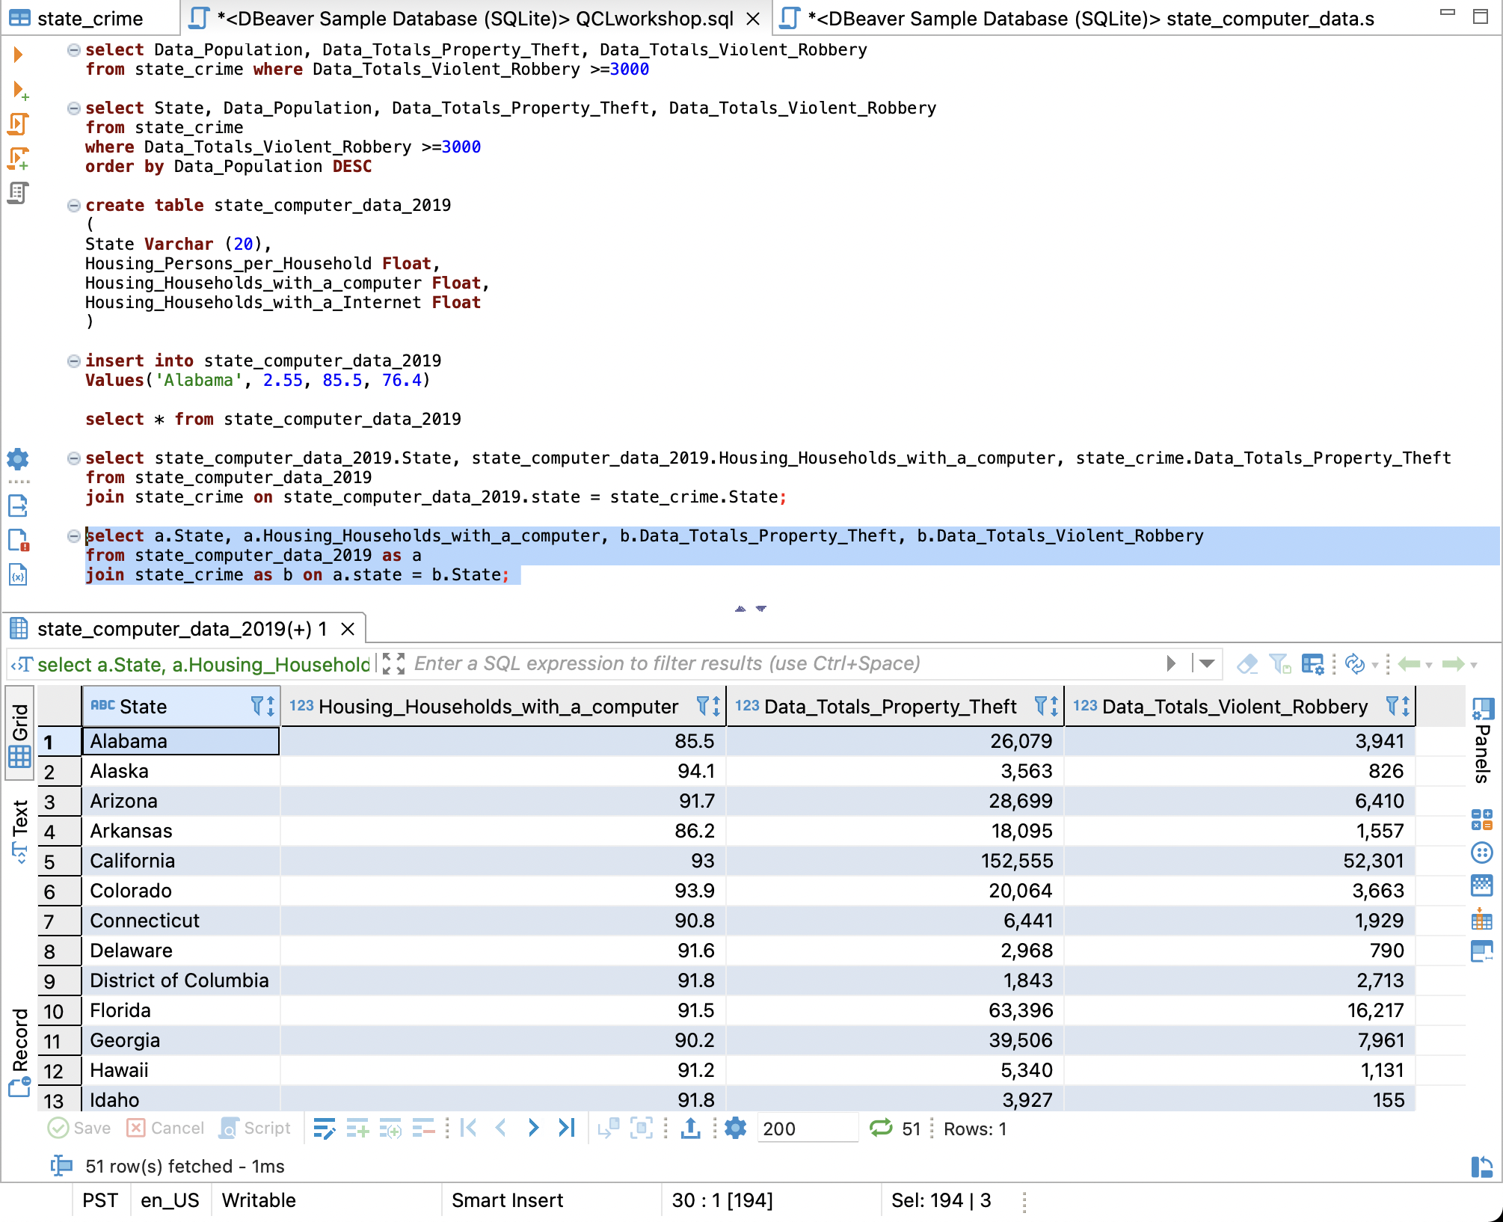

Slide 57
Activity #4 – Inner Join with Alias
Create an inner join using aliases with tables state_workforce and state_people, make sure to view attributes state, Mean_Travel_Time_to_Work, and Employment_Firms_Total

Slide 58
Writing Query
Select – Returns the data that was requested
From – choose a table to draw information from
Join – matches records from different tables
Where – filters data bases on request
Group By – aggregates the data
Having – filers aggregated data
Order by – sorts the data
Limit – limit the number of rows returned

Slide 59
Operation Order
From – choose a table to draw information from
Join – matches records from different tables
Where – filters data bases on request
Group By – aggregates the data
Having – filers aggregated data
Select – Returns the data that was requested
Order by – sorts the data
Limit – limit the number of rows returned

Slide 60
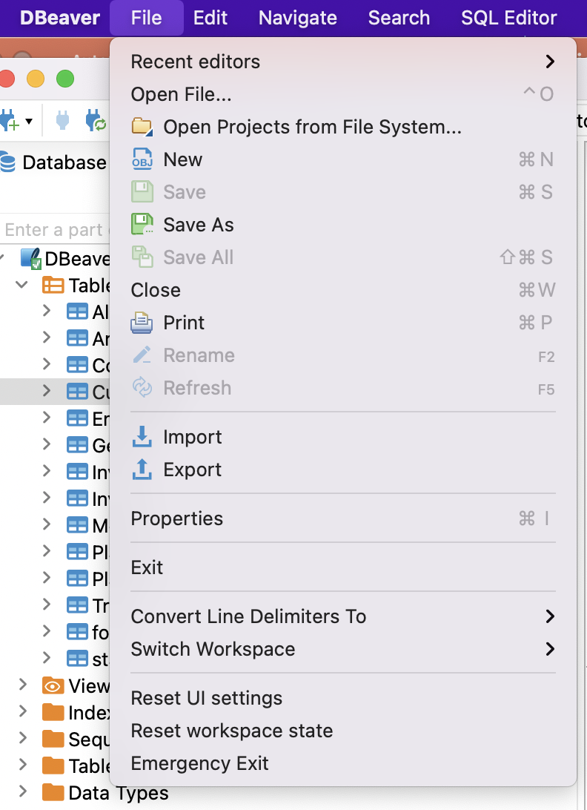
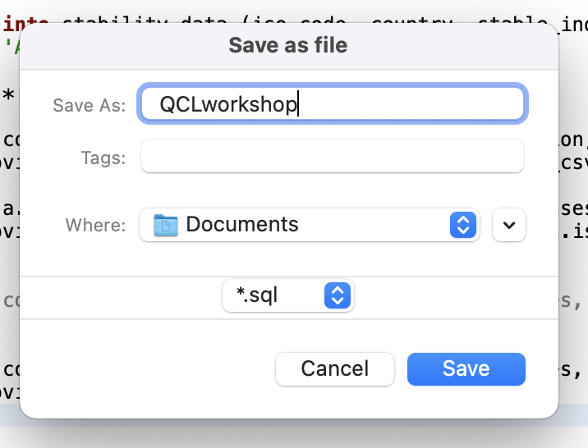
Save

Slide 61
Resources
Dbeaver Wiki - https://github.com/dbeaver/dbeaver/wiki
W3schools - https://www.w3schools.com/sql/default.asp
Code Academy- https://www.w3schools.com/sql/default.asp
Quizlet - https://quizlet.com/ (for vocab testing)
Best way to learn
SQL Murder Mystery - https://mystery.knightlab.com/

Slide 62
Contact info
QCL: QCL@cmc.edu
Vanessa Casillas: vanessa.casillas@claremontmckenna.edu

